Slide 1
Welcome to the Danish Presidency of EUPAN
September 2025

Slide 4


The Digital Task Force for Artificial Intelligence
September 2025
[16. december 2022]
Rigsarkivet & Statens Analyser og Implementering
[16. december 2022]
Rigsarkivet & Statens Analyser og Implementering

Slide 5



Who am I?
Danish Ministry of Climate, Energy and Utilities (KEFM)
2014 - 2024
KEFM’s employee on loan in the Task Force 2024 -

Slide 6
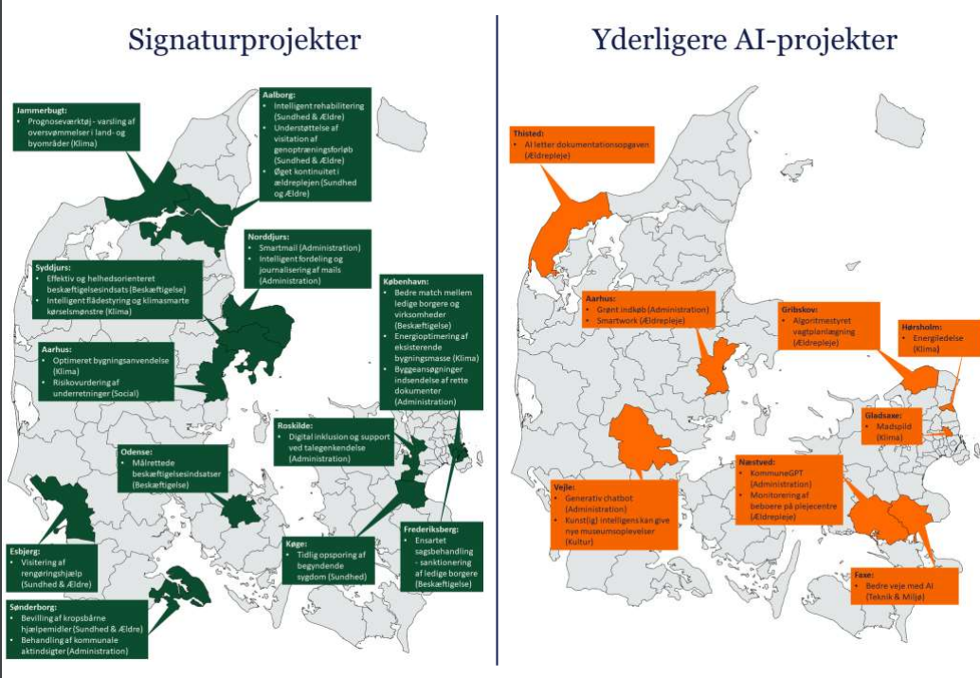
Local initiatives underway | Need for more coordination and decisiveness
”Diagnosis”
Examples of AI-projects at the municipal level
Parallel local initiatives require everyone to “reinvent the wheel” and address the same challenges.
The pace is too slow and level of ambition too low, and both depend on local commitment
Lack of attention to cross-cutting solutions
No uniform and coordinated approach to harvesting potentials
Great potential in the joint use of generative artificial intelligence – increased productivity and better service
Signature projects
Additional projects
The answer is a new Digital Task Force:
Digital Task Force for artificial intelligence
The government, Local Government Denmark (KL) and Danish Regions agree that the public sector in Denmark must be a global leader in the use of artificial intelligence. On this background, the government, KL and Danish Regions agree to establish a new Digital Task Force for artificial intelligence. The Task Force will set an ambitious common direction for the roll-out and use of artificial intelligence in the public sector. The Task Force’s work will help to free up labour, reduce administrative tasks, and increase quality in the public sector to the benefit of citizens and businesses, cf. attachment 2.

Slide 7
Vision | More time for what is important
Vision and goals for 2030
More time for what is important
Through the use of artificial intelligence, employees, citizens, and businesses can free up more time for what is important
An efficient and innovative public sector
Using artificial intelligence in our work and organization ensures that resources are used where they provide the most value and that new solutions and services are continuously developed. This will free up resources where there is a labour shortage.
Customized and easy interaction with government agencies
The use of artificial intelligence in our work and organization makes citizens’ and businesses’ encounters with the public sector easier, simpler, and more personal.
Enhanced professionalism and focus on the core task
Using artificial intelligence in our work and organization enhances the professionalism of public employees and supports, among other things, more time for citizen- and business-oriented tasks.
Measuring points
Freeing up time / FTEs
Removal of unclear and outdated legal barriers
Broad use in the agencies where the technology creates value
Easier and simpler interaction for citizens and organizations
Professional support for employees

Slide 8

Prerequisites | Necessary prerequisites for upscaling
Legal framework
The Task Force will work to ensure that legislation keeps pace with developments in artificial intelligence. Efforts will be made to establish legal bases and clarify current and future rules for the use of AI in the public sector.
Data and infrastructure
Effective use of artificial intelligence requires good data and a modern, robust infrastructure. Poor data quality and standardization limit the possibilities for developing successful solutions. The Task Force will therefore focus on joint solutions and initiatives that strengthen access to data and standards across the public sector.
Organizational frameworks, trust, and competencies
Effective dissemination of artificial intelligence requires strategic coherence and support for change in the public sector. Trust and quality must be maintained through skills development so that managers and employees understand and use AI responsibly. The Task Force will support this transition as a joint task for the entire public sector.

Slide 9


Organization
Succeeding with AI is mainly about the organization...
80%
Technology
20%

Slide 10



Project areas | Current projects in the Task Force
Area
Status
Cross-cutting
Symposium and identification of large-scale AI projects
Focus: Identification of three large-scale AI projects that can be rolled out widely in the public sector.
Next step: The symposium has just been held. Now it is time for prioritization in the Task Force's board and political committees.
Solutions
Speech-to-text documentation in healthcare and elderly care
Focus: Widespread rollout of speech-to-text documentation in the public sector, including in municipal elderly care and health services.
Next step: Continued focus on establishing a legal basis and proposals for widespread rollout. The Task Force's work is supplemented by input from the symposium.
Solutions
Digital assistant targeted at employees, citizens, and businesses
Focus: Opportunities and potential for digital assistants targeted at public sector employees, citizens, and businesses.
Next step: Formulation of proposals for how and at what level of ambition assistants can be developed and implemented in the public sector. The Task Force's work is supplemented by input from the symposium.

Slide 11


Project areas | Current projects in the Task Force
Area
Status
Focus: Providing a legal basis for the use of artificial intelligence in the public sector. This will take the form of legislation being included in the legislative program for 2026/2027 at the latest. In parallel, the Task Force is working on supporting initiatives for ministries with regard to providing a legal basis, including in the area of employment.
Next step: A proposal to the Task Force's board committee on legislative models (either through a main law in a general approach or through model law provisions in a sector-specific approach) for establishing a legal basis is expected in October.
Providing the legal basis
Focus: Establishing clearer frameworks for the use of cloud computing for AI in the public sector, including in relation to the processing of personal data, the market for cloud services, and issues of digital sovereignty.
Next steps: Ten possible solutions have been identified, which will be explored and further qualified. Based on this exploration, a recommendation will be prepared for the Task Force's board of directors on the launch of initiatives in early 2026.
Clear framework for using the cloud for AI

Slide 12
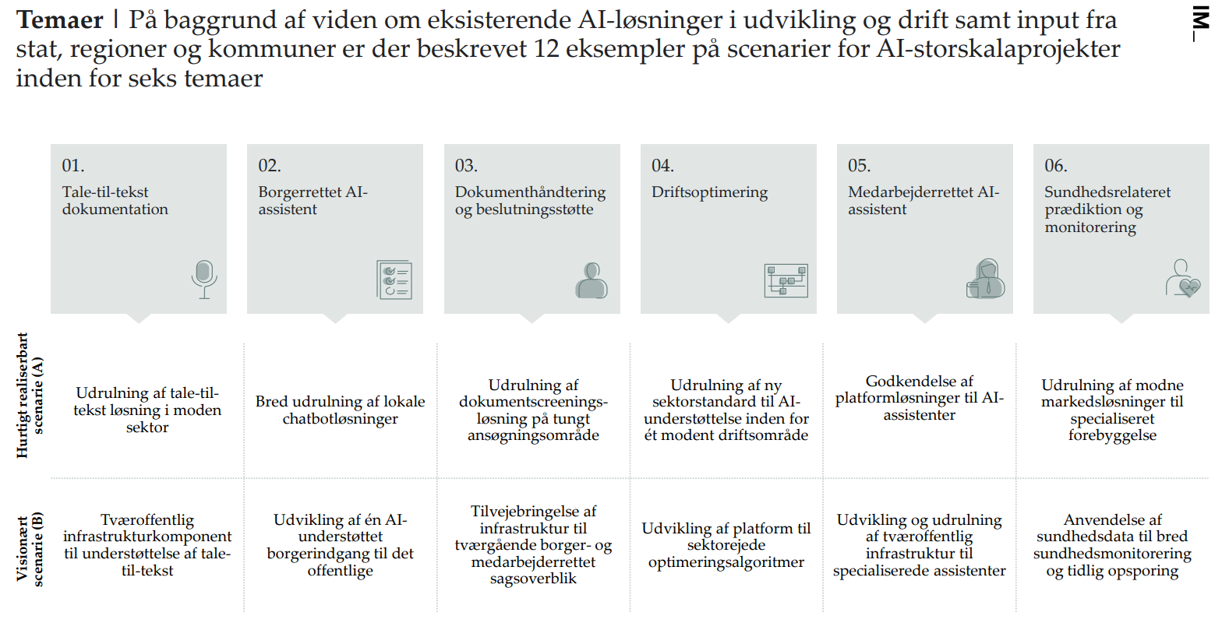
Themes | Based on knowledge of existing AI solutions in development and operation, as well as input from the state, regions, and municipalities, 12 examples of scenarios for large-scale AI projects within six themes are described.
Speech-to-text documentation
Citizen oriented AI-assistant
Document handling and decision support
Operational optimization
Employee oriented AI-assistant
Health-related prediction and monitoring
Rollout of speech-to-text solution in the mature sector
Widespread rollout of local chatbot solutions
Rollout of document screening solution in high-volume application area
Rollout of new sector standard for AI support within one mature area of operation
Approval of platform solutions for AI assistants
Rollout of mature market solutions for specialized prevention
Quickly feasible scenario (A)
Joint public infrastructure component to support speech-to-text
Development of a single AI-supported citizen portal to the public sector
Provision of infrastructure for cross-cutting citizen and employee case overviews
Development of a platform for sector-owned optimization algorithms
Development and rollout of cross-public infrastructure for specialized assistants
Use of health data for broad health monitoring and early detection
Visionary scenario (B)

Slide 13



Programme | The task force has an ambitious programme, which will be expanded with at least three large-scale AI projects based on the symposium
2025
2026
2027
Period
Q1
Q2
Q3
Q4
Q1
Q2
Q3
Q4
Q1
Q2
Project track
Milepæle
Cross-functional
Program management and governance for realizing the target vision
Legal and infrastructure: Providing a legal basis and a clearer framework for use in the cloud
Prerequisites
Legal : The provision of a legal basis
Speech-to-text
Solutions
Digital assistents for employees
Large scale AI-projects
Digital assistant for citizens and companies

Slide 14
Examples of potential
[16. december 2022]
Rigsarkivet & Statens Analyser og Implementering
[16. december 2022]
Rigsarkivet & Statens Analyser og Implementering

Slide 15
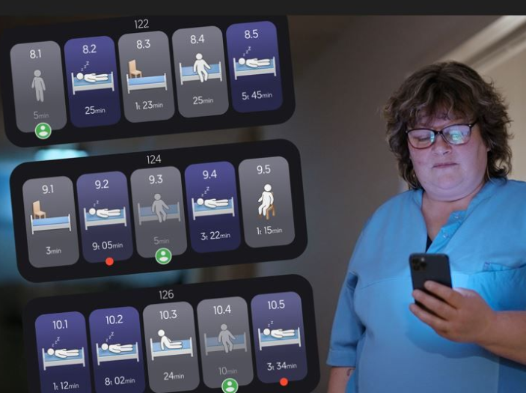
AI-driven care system
How does it work?
A sensor in residents' homes detects and reports significant movements to staff via an app – for example, if a resident sits up in bed to leave it.
Compliance
The system does not store images of residents and only shows an outline of them. This means that residents cannot be recognized in other contexts and are therefore anonymized.
How does it help?
Fewer staff-induced awakenings, fewer falls, reduced staffing requirements.

Slide 16
Automated documentation – speech-to-text
2.4 million citizen consultations per year – in the area of employment alone
Approximately 1.5 hours of preparation and documentation per consultation – 3.6 million hours per year
What if AI could create a journal entry and reduce the time spent on the task?

Slide 17
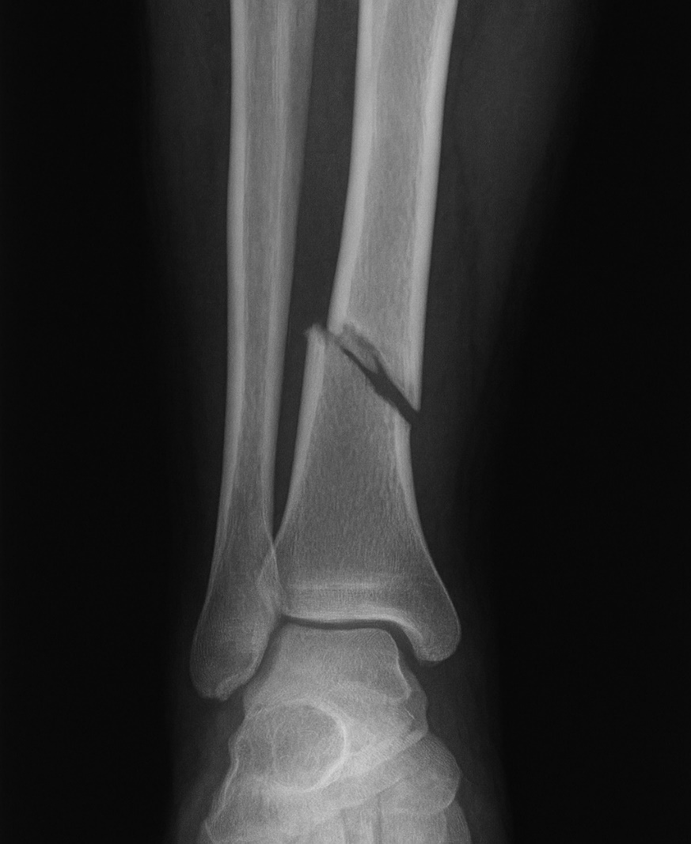
AI and bone fractures
How does it work?
Artificial intelligence can determine with a high degree of certainty whether there is a fracture based on an X-ray image. It is used to assess which patients should be seen first and whether some can be sent home again.
How does it help?
Can help reduce waiting times and streamline patient flow in the emergency room – fewer bottlenecks.
The solution allows nurse practitioners or doctors who have not completed a full medical degree to independently complete the treatment of the patient – without first having to consult an authorized doctor.

Slide 18
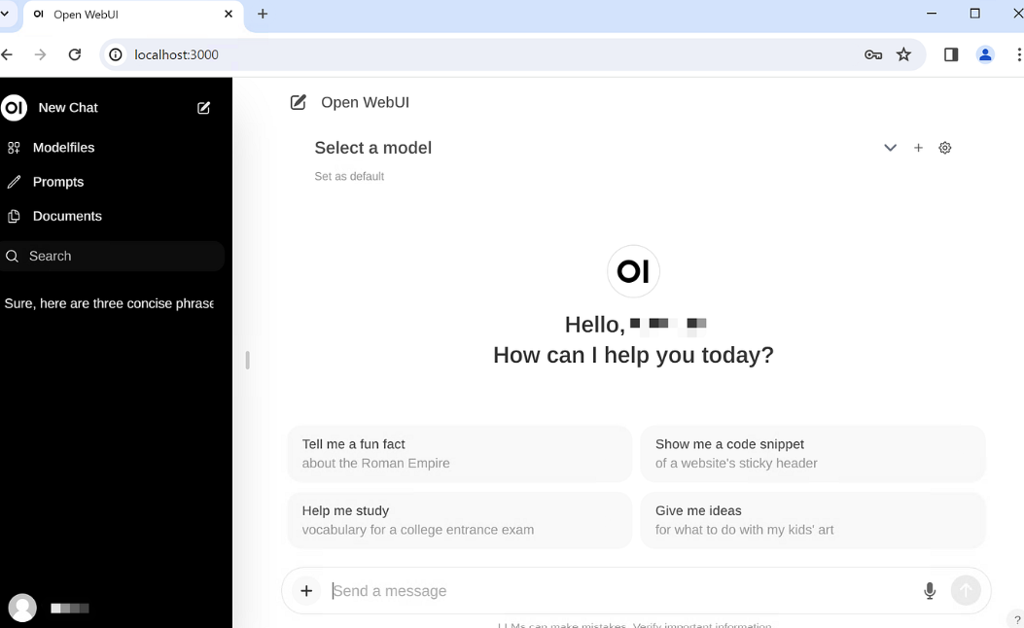
Digital assistent for employees
Since 2022, chat-based LLM-driven digital assistants have been presented as an essential part of the expected solution to future AI needs in the labor market. These solutions offer opportunities to make task completion both faster and better, provided they are used intelligently in daily work processes in closed, secure IT environments.
The Task Force sees the primary potential when authorities have the opportunity to tailor the assistant, e.g. by providing access to internal material and developing specialists and agents based on that knowledge.

Slide 19



Visualization of a possible user interface for a digital assistant aimed at citizens
In collaboration with the Danish Agency for Digital Government, the Task Force has developed a proposal for how a digital assistant might look and function.
The visualizations show examples of specific tasks and functions that the assistant could perform, as well as how the functions could be improved if citizens logged into the assistant, giving it access to, for example, their master data and digital post in order to help them fill out forms.
The digital assistant as an app
The digital assistant as a website

Slide 20
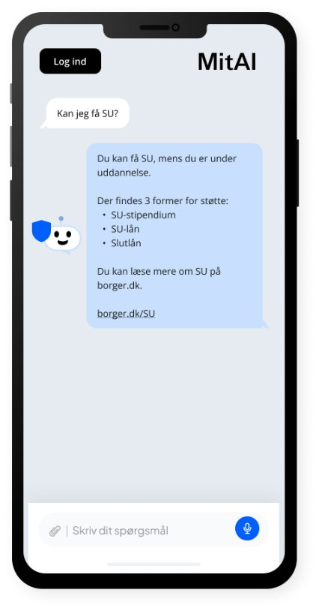
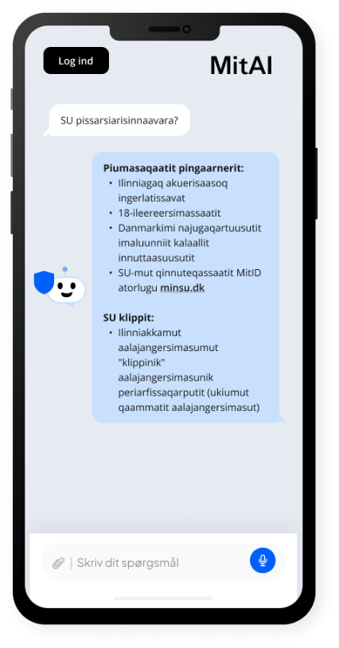
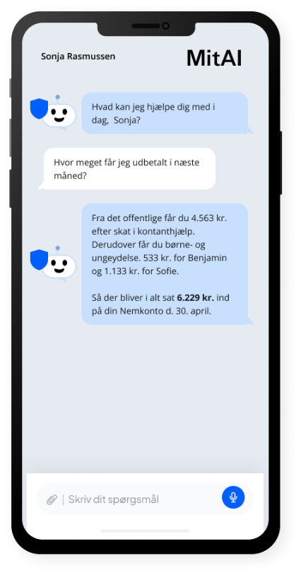
Visualization of possible functionality for a digital assistant aimed at citizens
A digital assistant that can respond in multiple languages
A digital assistant that can access citizens' own data

Slide 21
Questions?
[16. december 2022]
Rigsarkivet & Statens Analyser og Implementering
[16. december 2022]
Rigsarkivet & Statens Analyser og Implementering

Slide 22
Digitaskforce.dk
[16. december 2022]
Rigsarkivet & Statens Analyser og Implementering
[16. december 2022]
Rigsarkivet & Statens Analyser og Implementering

Slide 24
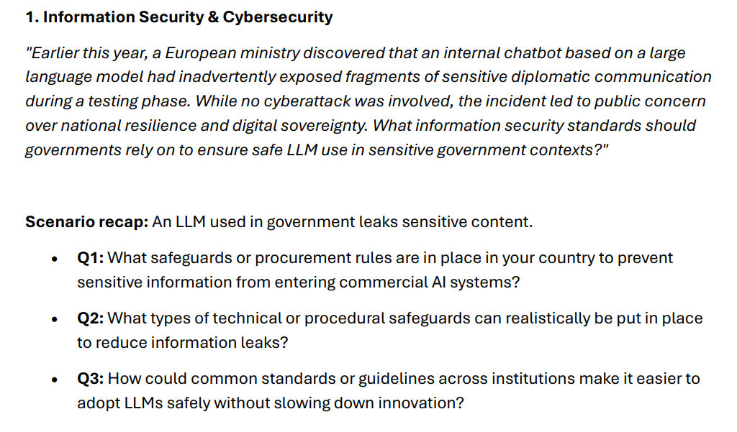

Slide 25
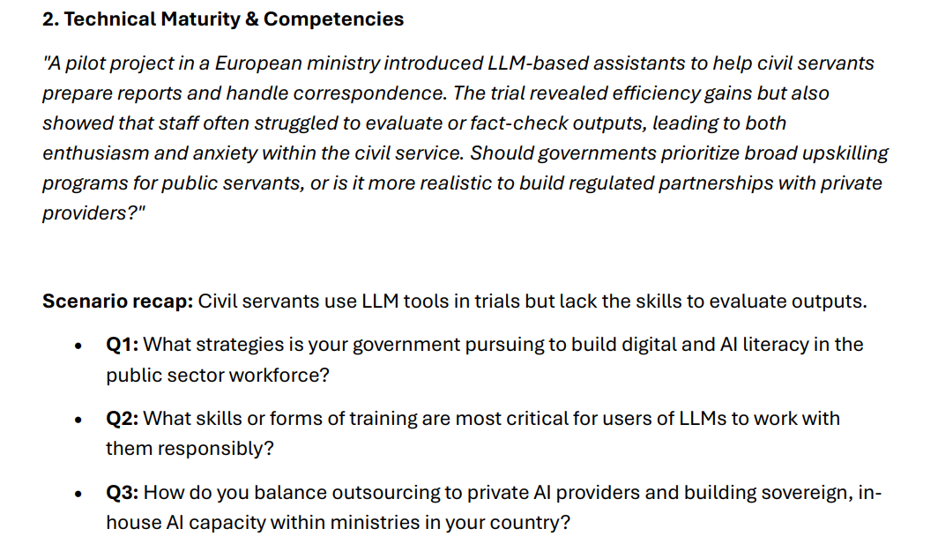

Slide 27




From the Western Balkans to Europe: Shape a Common Administrative Future
Ivana PETRICEVIC, Partnership and Knowledge Management Officer – Regional School of Public Administrations (ReSPA)
EUPAN Working Level Meeting, 29-30 September 2025, Copenhagen
Building together governance for the future

Slide 28



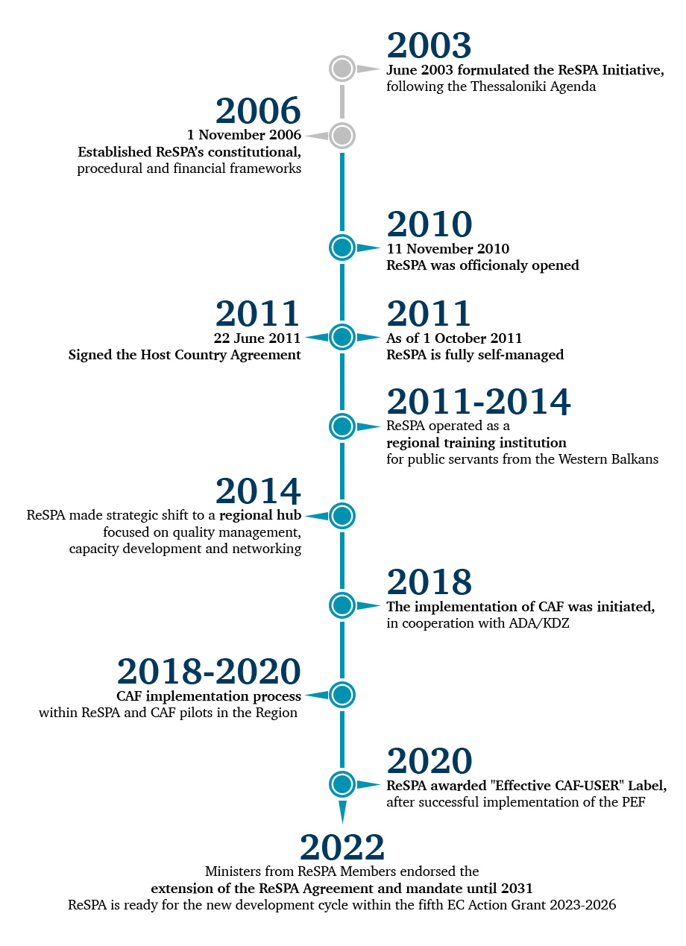

Building together governance for the future
Regional School of Public Administration - ReSPA
Established in 2010 as a joint initiative of the Western Balkan Governments and the European Commission;
Managed and governed by five members: Albania, Bosnia and Herzegovina, Montenegro, North Macedonia and Serbia, while Kosovo* is a beneficiary;
Mandate: Strengthening civil service capacities & regional cooperation
Had two phases of evolution:
  Phase I: regional school for training civil servants from the Western Balkan region
  Phase II: regional hub of knowledge sharing, learning, research and policy analysis
* This designation is without prejudice to positions on status, and is in line with UNSCR 1244 and ICJ Advisory opinion on the Kosovo Declaration of Independence

Slide 29
Building together governance for the future
ReSPA in Numbers
15.000+ participants (public servants across the WBs)
900+ networking and capacity building activities
100+ technical assistance projects deployed to the region
60+ regional mobility schemes
ReSPA in Policy Impact
The only Ministerial platform on the PAR processes in the Western Balkans region
Recognized in the EU-Western Balkan Summit Declarations
From the Western Balkans to Europe: Shape a Common Administrative Future | 30/09/25 | Page 2 |

Slide 30

Changed Context
Building together governance for the future
EU accession process – different stages
New methodology - public administration as one of the fundamentals
Principles of Public Administration (SIGMA)
From training to knowledge hub
From intraregional cooperation to enhanced cooperation with EU MSs
02
03
04
05
From the Western Balkans to Europe: Shape a Common Administrative Future | 30/09/25 | Page 3 |

Slide 31
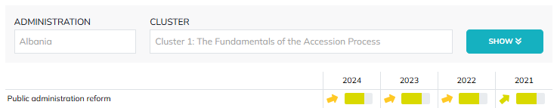
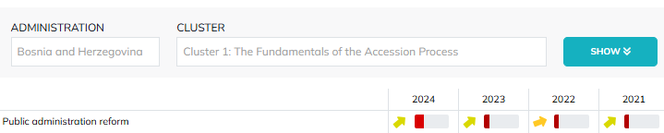
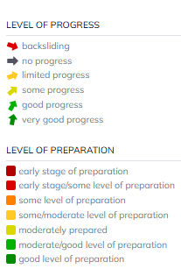
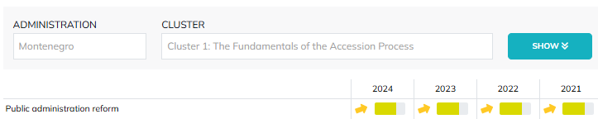
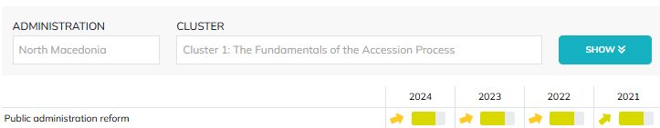
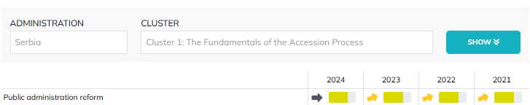
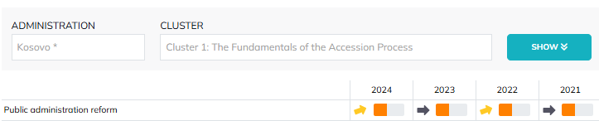
Building together governance for the future
Accession Negotiations
From the Western Balkans to Europe: Shape a Common Administrative Future | 30/09/25 | Page 4 |

Slide 32
Success Stories
Building together governance for the future
  Albania
  Use of AI in the translation and alignment of EU acquis;
  Bosnia and Herzegovina
  eKonsultacije; Establishing an HRM information system (HRMIS)
  Montenegro
  Ready4EU Programme; Transparency of Employee Numbers and Visualization of the Scope of Public Administration
  North Macedonia
  IT tool for monitoring and reporting on the implementation of the PAR strategy 2023-2030
  Serbia
  NAPA courses; Student internships
  Kosovo*
  Administrative Burden Reduction programme
02
03
04
05
From the Western Balkans to Europe: Shape a Common Administrative Future | 30/09/25 | Page 5 |

Slide 33
Innovation and Recognition
Building together governance for the future
Western Balkans Public Administration Awards (with SIGMA)
Staff Satisfaction Surveys → improved HR policies
Knowledge Management Platform (KMP) – www.kmp.respaweb.eu
Regional Quality Management Centre (CAF, certification in 30+ institutions)
Foresight
AI prompting
02
03
04
05
From the Western Balkans to Europe: Shape a Common Administrative Future | 30/09/25 | Page 6 |

Slide 34
Partnerships
Building together governance for the future
Joint programmes with MS (France, Italy, Ireland, Slovenia, Croatia, Greece, etc.)
Partnerships with schools (SNA, DSJU, INSP, EUI, College of Europe, Hertie, EIPA)
Engagement with EC Services (DG ENEST, DG JUST, DG GROW, DG Translation)
EU networks and bodies - DISPA meeting in Montenegro (16-17 October 2025) co-hosting with EuSA
02
03
04
05
From the Western Balkans to Europe: Shape a Common Administrative Future | 30/09/25 | Page 7 |

Slide 35
Mirroring European Approach
Building together governance for the future
PACE, TSI,
Mobility Programmes – possible hosting for the job shadowing segment in EU MSs
02
03
04
05
From the Western Balkans to Europe: Shape a Common Administrative Future | 30/09/25 | Page 8 |

Slide 36
Future
Building together governance for the future
Continue strengthening the links with the EU
Extending geographical scope
02
03
04
05
From the Western Balkans to Europe: Shape a Common Administrative Future | 30/09/25 | Page 9 |

Slide 37
Building together governance for the future
02
Thank you for your attention
03
04
05
From the Western Balkans to Europe: Shape a Common Administrative Future | 30/09/25 | Page 10 |

Slide 40

CYPRUS PRESIDENCY 2026
EUPAN Working Level meeting - Nicosia, 19 -20/3/2026
EUPAN WL Secretariat – online, week 9 - 13/2 (TBC)
EUPAN DG Secretariat – online, week 20 -24/4 (TBC)
EUPAN Directors General meeting – Nicosia, 26 -27/5/2026
Other relevant meetings:
EPSO: Network of Experts – Limassol, 29-30/4/2026
DISPA - Nicosia, 7-8/5/2026

Slide 41
CYPRUS Presidency 2026
I. Leadership and capacity to develop innovative and efficient services and HR policies will be strengthened
II. Participation and co-creation will strengthen trust and resilience of public administrations
III. The capacity of public administration for digital and green transformations will be strengthened
Strategic approach to HRM
Strengthening participation and trust through digitalisation
Evidence informed decision-making

Slide 42

Ireland’s Hosting of EUPAN
(H2 2026)
EUPAN Working Group Meeting
September 2025

Slide 43
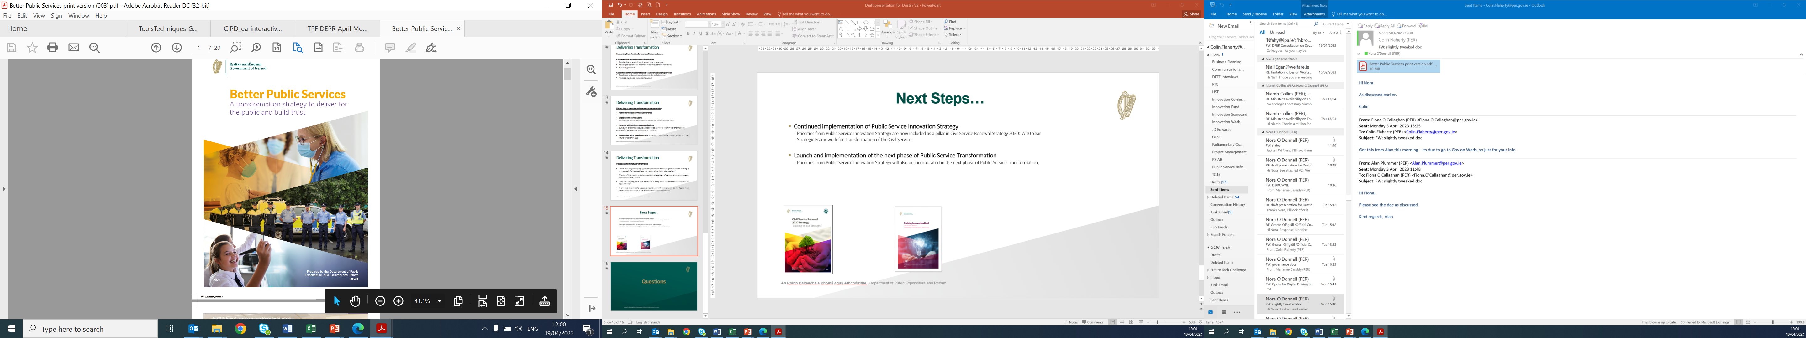
Background and context – Better Public Services
Aimed at delivering for the public and building trust
Building on achievements that have been made in recent years in sectoral programmes, shared services and procurement, digital delivery and government reform
Key learnings from COVID-19: Recognising the value of innovation and digital readiness, shared purpose and values, Public Service capacity and resilience
Positioning the Public Service to meet current and future challenges

Slide 44









Public Service Transformation Framework
Digital and Innovation at Scale
    Tackle big societal issues and drive societal change
    Achieve a seamless user experience and inclusive service delivery
    Provide a dynamic and agile workplace
    Deliver digitally enabled services and functions
    Support digital inclusion
    Provide joined-up services using MyGovID
    Develop scalable innovations and create dynamic workplaces
Workforce and Organisation of the Future
    Ensure that it is more diverse, agile and inclusive
    Ensure that it is skilled for the future
    Establish itself as an Employer of Choice
    Improve Equality, Diversity and Inclusion
    Upskill and reskill staff
    Develop and implement progressive HR policies
    Deliver effective human-centered policies and services designed with evidence and insights from our public and from our data and research
    Enable accessible and shared public service data
    Engage with the public in policy and service design
    Put service users first and embed systems and
    design thinking
    Pursue continuous improvement by identifying and removing all forms of waste
    Maximise utility of the Eircode, UBI, PPSN and MyGovID
    Share data safely across the Public Service
Evidence-informed policy and services designed for and with our public
Notes:
LEFT COLUMN: ‘Public Service will work together to…’
RIGHT COLUMN: ‘PSBs will identify and prioritise actions to…’

Slide 45
Broad Alignment with EUPAN Strategy
Skills Development, Reskilling and Upskilling
Ethical and Non-Biased use of Digital Tools and Emerging Technologies
Strategic Human Resources Management
Innovation, Experimentation, Behavioural Insights and Service Design
Integrity, Evidence and Prioritisation in Policymaking
Foresight and Anticipatory Practices
Diversity and Inclusion
Quality Management and Measuring Trust
Open Government, Co-Creation and Participatory Practices
Evidence-Informed Decision-Making
Ethical Use Of AI

Slide 46
Examples of Possible themes
Digital and Innovation at Scale
Life events approach to integrated service delivery
Digital Service Delivery
Workforce and Organisation of the Future
Future workforce trends
HR Model and capability
Cross-government working
Evidence-informed policy and services designed for and with our public
Design led public service transformation
Building trust in public institutions and public services

Slide 47



Planning and Indicative Dates
Cross-divisional project team established
Plan to host one of the EUPAN events as part of our Public Service Transformation Week
Most likely early November 2026 for WG meeting then late November 2026/early December for the DG meeting

Slide 48
Break

Slide 50
Top Public Management Toolkit
EUPAN Working Level Meeting
Lech Marcinkowski, SIGMA
Copenhagen, 30 September 2025

Slide 51
Table of contents
1 | Why TPM?
2 | SIGMA, Principle 10, challenges our countries face
3 | Topic covered in the booklets
4 | Illustrative examples
5 | The way ahead

Slide 52
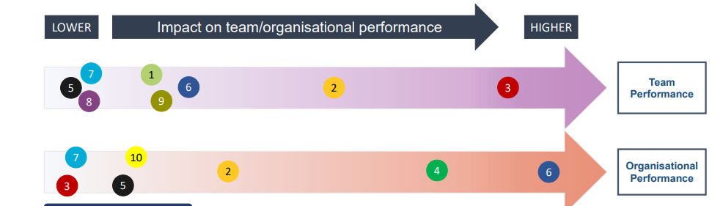
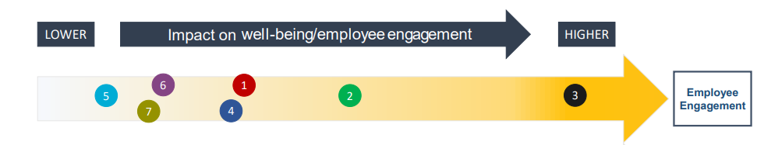
TPMs impact organisational performance and employee engagement
Source: The Standard EU/OECD Survey of Central Government Public Servants

Slide 53
Principle 10: Effective leadership is fostered through competence, stability, professional autonomy and responsiveness of accountable top managers.
The law establishes top managers as a specific category. The scope of top management is adequately defined, ensuring that senior managerial positions in ministries and agencies are not treated as political offices.
Top management positions are made attractive through fair recruitment, competitive remuneration, professional challenges, autonomy and mitigation of career risks.
Recruitment procedures are merit-based, professionally led, impartial and transparent, allowing selection and appointment of top managers with sufficient high-level experience, knowledge, skills and competencies to perform their job well against predefined standards.
Recruitment policies and practices support equal opportunities, gender balance and non-discrimination in top managerial positions.
Top managers in public administration have clearly defined objectives, aligned with the mission of the organisation and objectives of the government, and their performance is regularly assessed.
Top managers in public administration have sufficient professional and managerial autonomy, enabling them to assume responsibility for the management of staff, resources and work.
Top managers in public administration develop their skills in line with the needs of the job, both present and future.
Stability of top management fosters the continuity of institutional performance and memory.

Slide 54
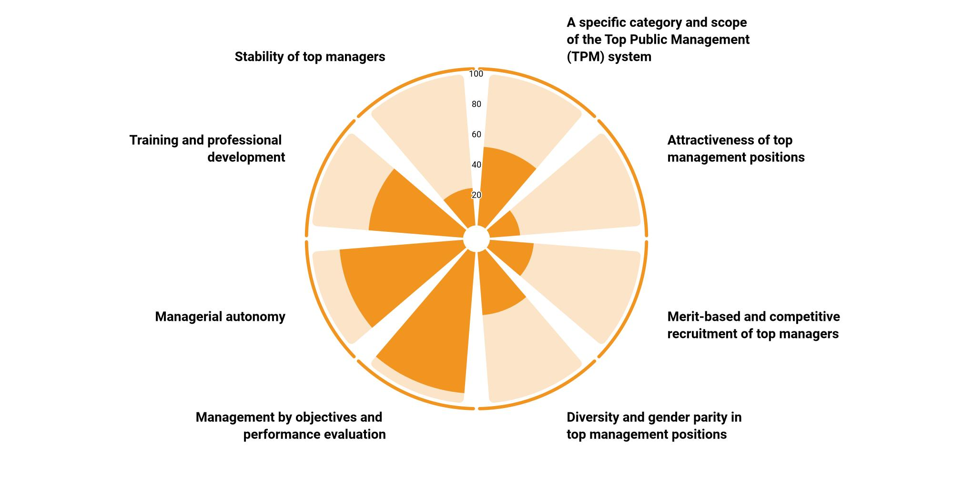
Professional top managers – assessment results for WB, 2024
Source: Principles of Public Administration Data Portal, https://par-portal.sigmaweb.org.

Slide 55

Get to the details
Should the TPM selection body be under the Parliament or the Government?
Who should be heading a selection panel if it is composed of public servants and external experts?
If directors are appointed for a fixed-term, can their mandate be extended (and under what conditions)?
Can early dismissal decision be appealed to court?
Can acting top public managers come from outside of civil service?
What should be appraised – TPM’s performance or their organisation’s performance?
Can a TPM earn more than their minister?
Notes:
Rarely we can give

Slide 56
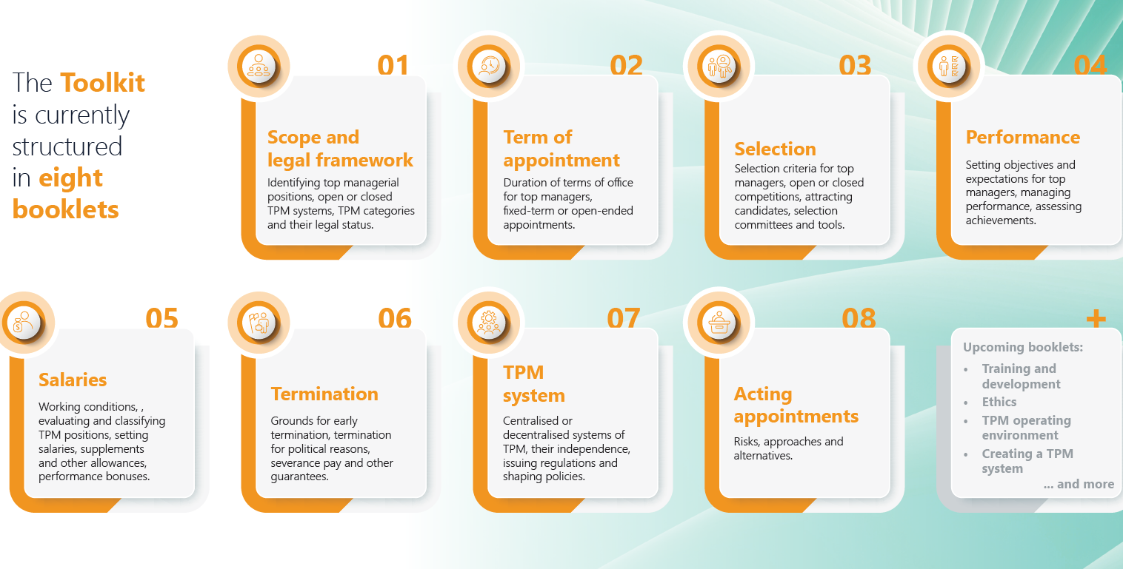
TPM Toolkit: 8 booklets
-cover page

Slide 57
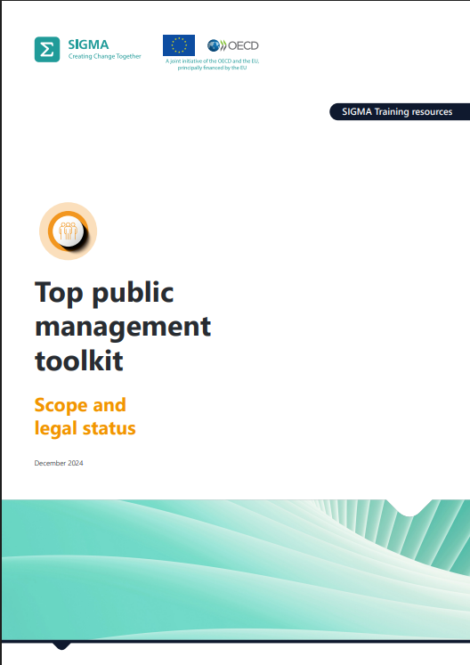
Scope and legal status – topics covered
Horizontal scope
Vertical scope
Categories within TPM
Open and closed TPM systems
TPM as a defined group
Legal status and applicable employment framework

Slide 58
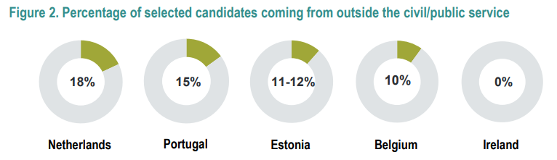
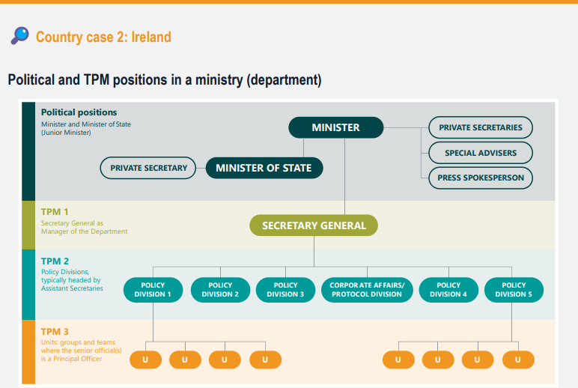
Scope and legal status (2)
💡 Toolkit advice Create an open TPM system Transitional countries without a strong and long-standing civil service system should create an open TPM system. As a potential exception, a country with a prestigious and consolidated national civil service, strongly based on merit, may consider the advantages and disadvantages of opening or not these positions to non-civil servants. Of the nine benchmark countries, seven use an open system.

Slide 59
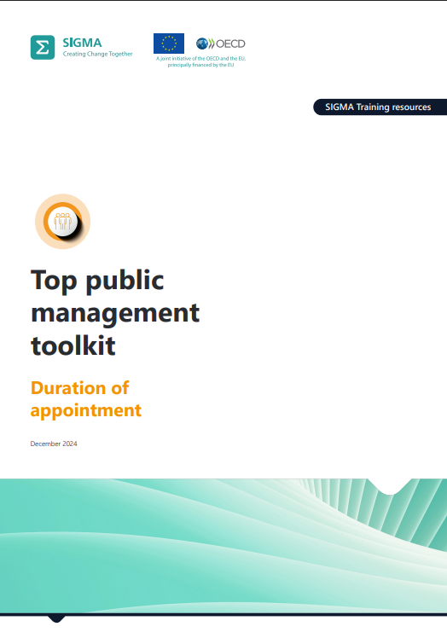
Duration of appointment – topics covered
Fixed-term
Open-ended
TPM duration in practice

Slide 60
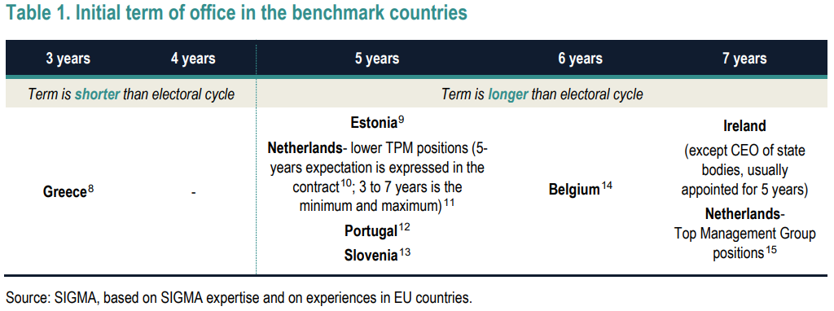
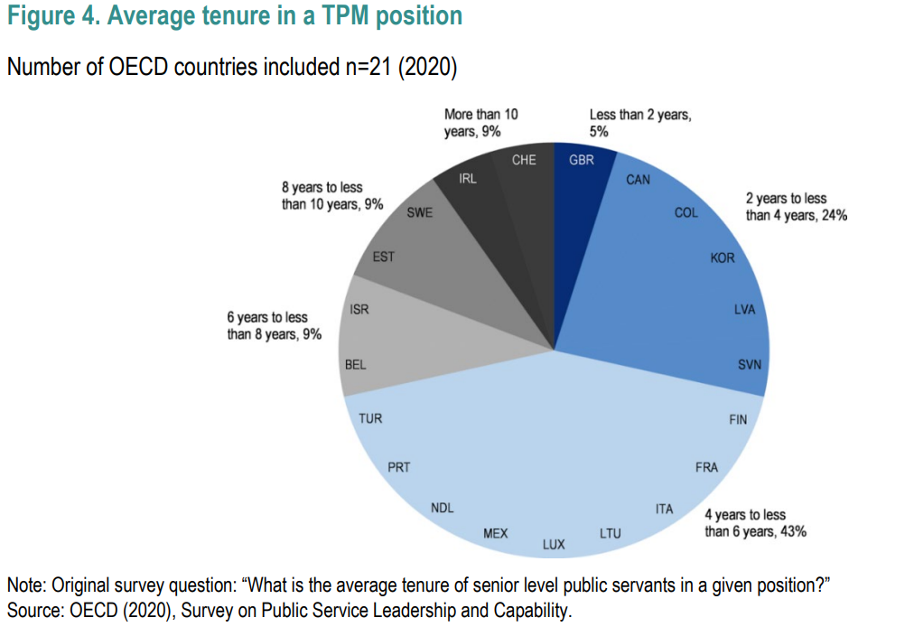
Duration of appointment (2)
💡 Toolkit advice Initial term For fixed-term appointments, define an initial term at least one or two years longer than the electoral cycle (usually set at 4 or 5 years).

Slide 61
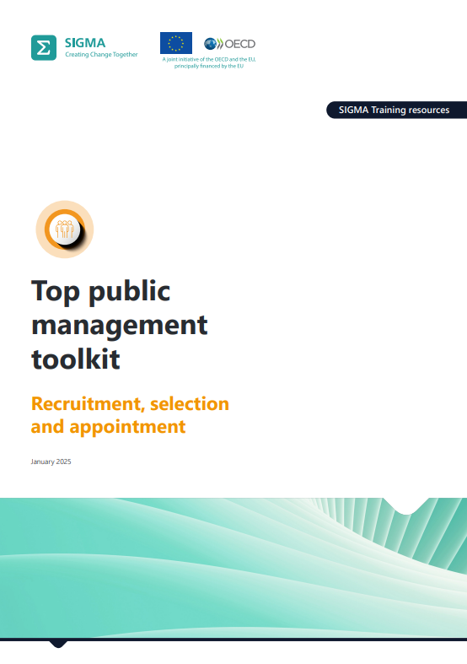
Recruitment, selection and appointment – topics covered
Specificities of the selection process
Defining the profile of candidates
Attracting applicants
Who is running the process
Selection tools
Preparing a shortlist
Appointment decision
Some other issues during and after the appointment

Slide 62
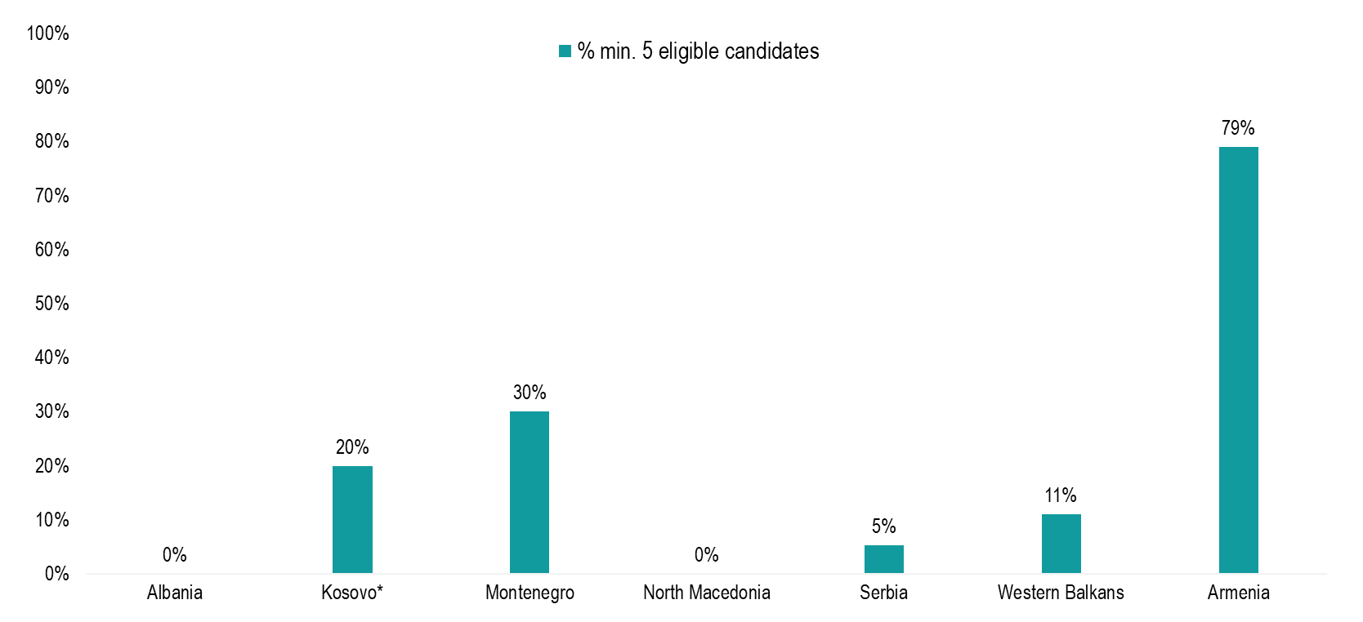
Competitiveness of recruitment to TPM jobs
Notes: Data unavailable for Bosnia and Herzegovina and Moldova. The Western Balkans average is a simple average based on available data from the six Western Balkan administrations.
Source: SIGMA analysis based on information provided by the administrations.

Slide 63
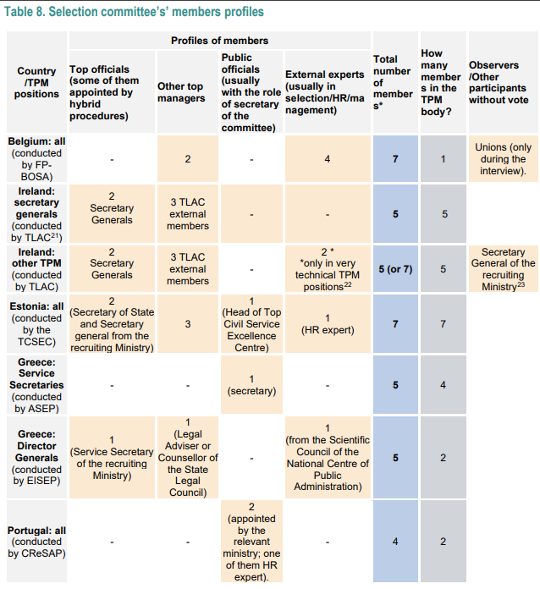
Recruitment, selection and appointment (2)
Country | Average number of applicants per TPM position (2022) | Observations
Belgium | 12,2
Estonia | 6,9
Germany | 5-10 | Estimation, not based on real data (for the TPM positions open to internal competition)
Greece | 28,0
Ireland | 17,4
Portugal | 5,9 | 22 processes were repeated because initially received less than 3 applicants
Slovenia | 1,9 | In the 51% of the cases, only one applicant

Slide 64
Recruitment, selection and appointment (3)
💡 Toolkit advice Avoid short application deadlines. To maximise the number of applicants, attract non-civil servants, and especially individuals working in senior positions in the private sector, the application deadline should be sufficiently long, at least 20 days or longer, especially if there are expecting difficulties attracting candidates. When the announcement is published close to a vacation period, it is a good practice to extend the deadline to remove obstacles to potential applicants. It is also recommendable to extend the deadline whenever only a few individuals have applied to a position. In addition, it is better to define deadlines in calendar days, avoiding the use of business/working days as that may be confusing.
💡 Toolkit advice Devote adequate attention to attracting candidates. A selection process can only deliver good results if it has been able to attract a sufficient number of qualified applicants. Therefore, it is recommended to prepare a clear, complete and attractive vacancy announcement and to conduct a specific dissemination campaign, tailor-made to the position, mainly using digital tools, but potentially including specific onsite events, more adequate to provide credibility to the selection process and to solve eventual doubts of outsiders. The use of head-hunters may be considered. In any case, a proactive approach, using communication channels inspired by head-hunting practices is recommended.
💡 Toolkit advice Fully separate the selection of TPM officials conceptually from the selection of other public servants. Each country should analyse and decide if certain parts of the selection process may be managed by the same body or unit in charge of selection for the regular public service or not.

Slide 65
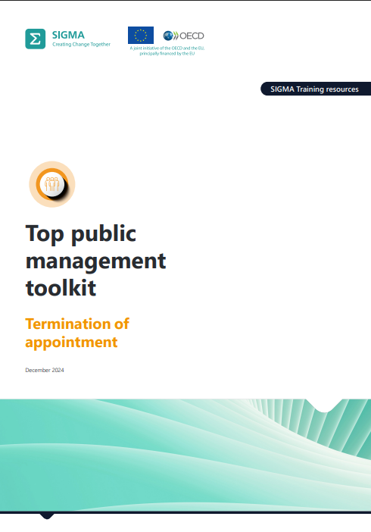
Termination of appointment – topics covered
Dismissal and demotion of TPM
Legally accepted reasons for early termination
Reorganisation-related termination
Performance-related termination
Termination for political reasons
Transparency of termination decisions
Severance pay
Appeals against early termination decisions

Slide 66
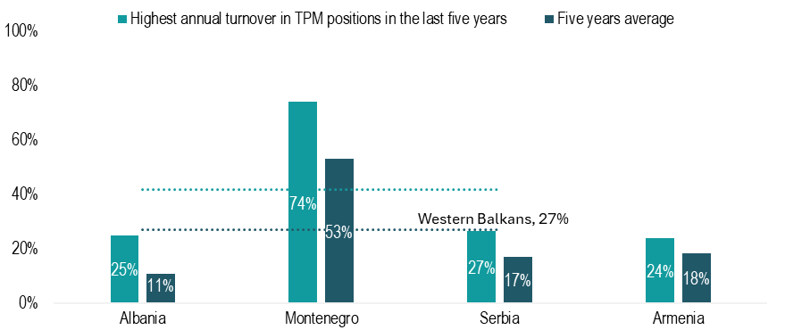
Stability in TPM roles
Western Balkans, 42%
Notes: Data unavailable for Bosnia and Herzegovina, Kosovo and North Macedonia. The Western Balkans average is a simple average based on available data from the six Western Balkan administrations.
Source: SIGMA analysis based on information provided by the administrations.

Slide 67
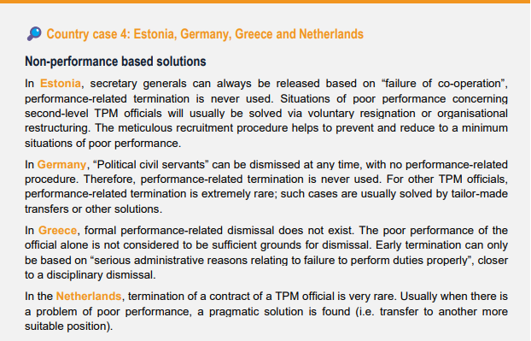
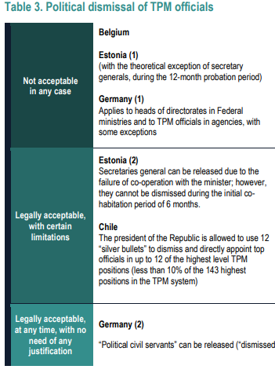
Termination of appointment (2)
💡 Toolkit advice When creating a TPM system, it is advisable to explicitly recognise the right to appeal, as for any administrative decision, but to guarantee procedures to discourage purely political dismissals as much as possible, and to ensure adequate information, dignity and reasonable compensation to the dismissed TPM official. Due process and human care should contribute to solve the early termination in a reasonable way, avoiding the judicial procedures that may have negative impacts on different dimensions.

Slide 68
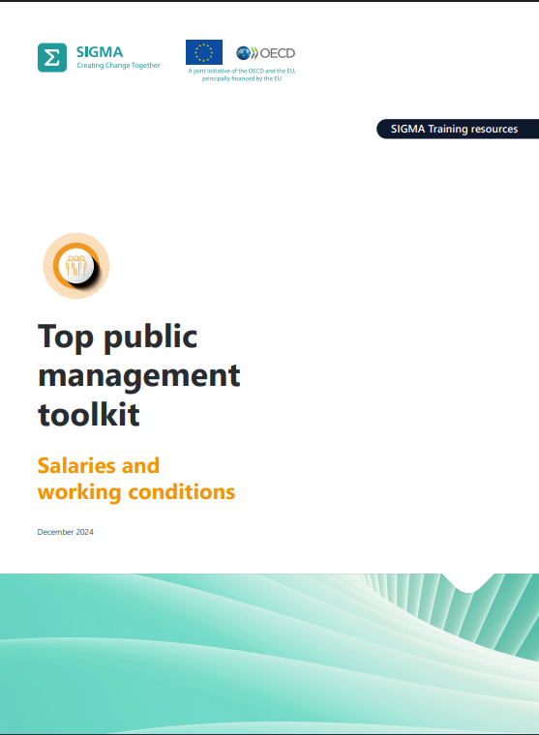
Salaries and working conditions – topics covered
How to define TPM salaries
How to classify TPM positions
Salary progression and seniority suppl.
Other fixed pay components
Performance bonuses
Comparing TPM pay
Salaries after TPM position
Management of the TPM salary system
Working conditions, rights, pensions and other income

Slide 69
Attractiveness of salaries in TPM positions
Notes: The value for Bosnia and Herzegovina is the simple average of the state level, the Federation of Bosnia and Herzegovina and the Republika Srpska. The Western Balkans average is a simple average based on available data from the six Western Balkan administrations.
Source: SIGMA analysis based on information provided by the administrations.

Slide 70
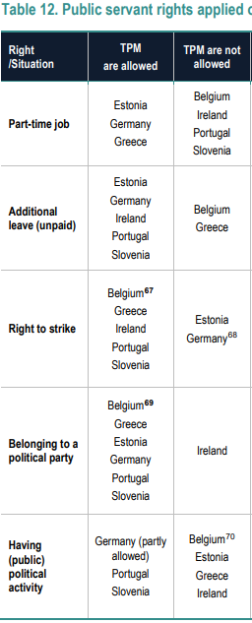
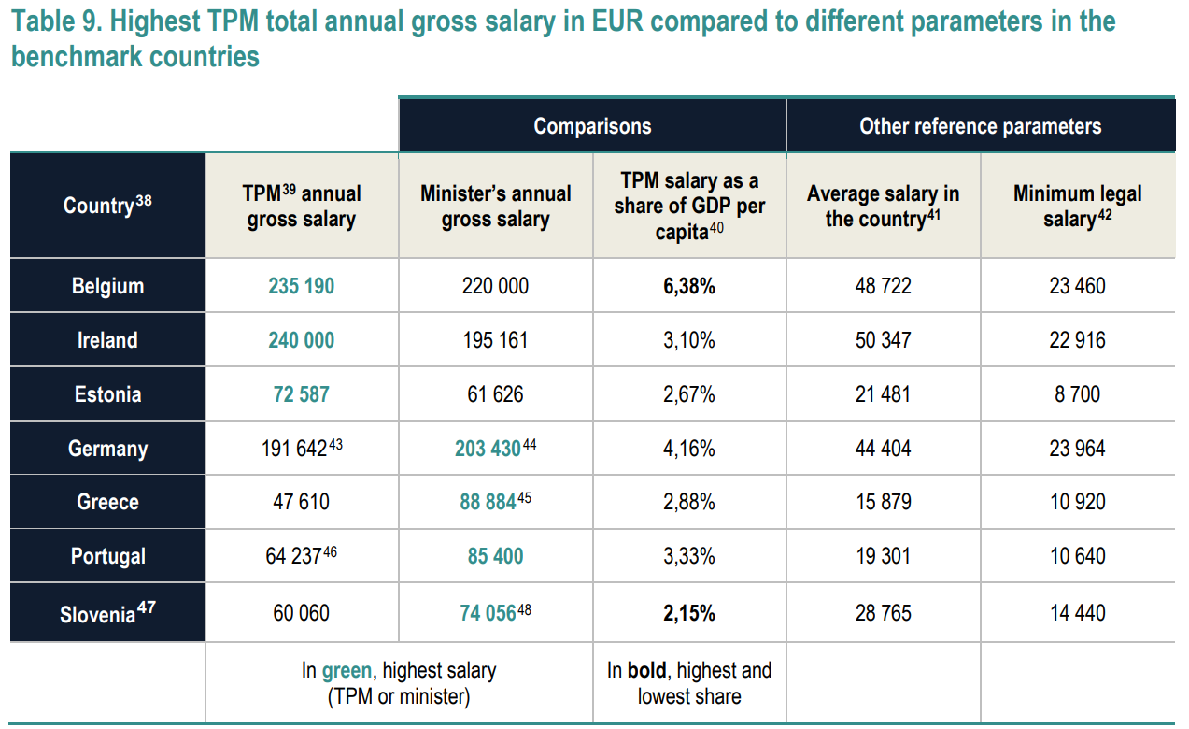
Salaries and working conditions (2)

Slide 71
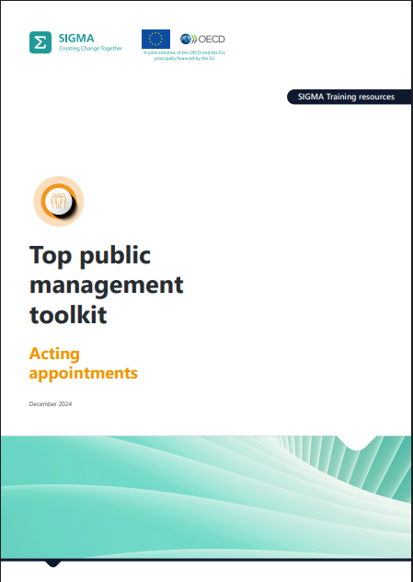
Acting appointments – topics covered
What is an acting appointment
The risks created by acting appointments:
  “indefinite” acting appointments
  Advantages during competitions
  Discouragement of potential candidates
Alternative solutions
Seven approaches to reduce acting appointments or minimise their negative consequences

Slide 72
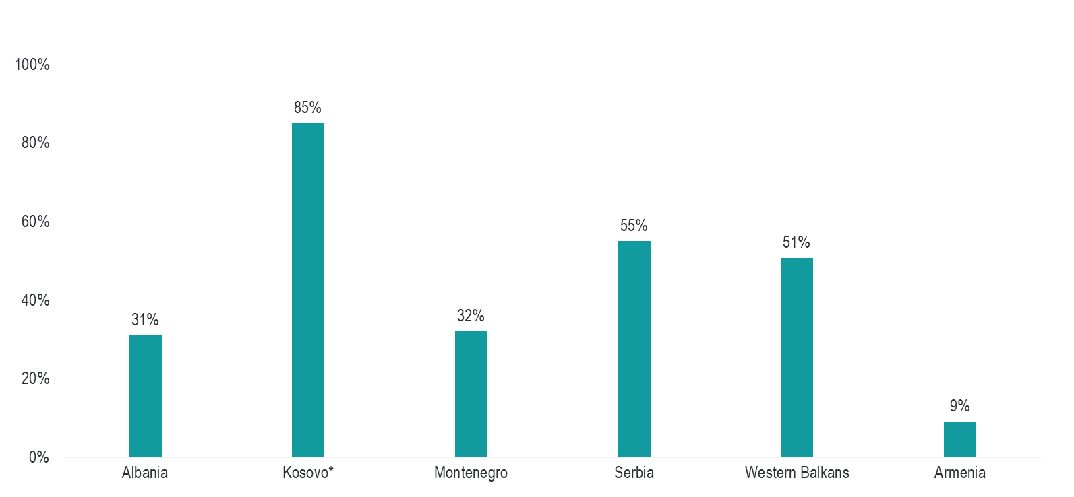
Share of acting appointments in TPM roles
Note: Data unavailable for Bosnia and Herzegovina and North Macedonia.
Source: SIGMA analysis based on information provided by the administrations.

Slide 73
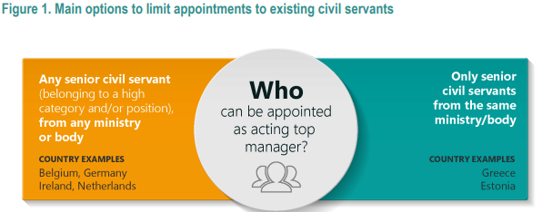
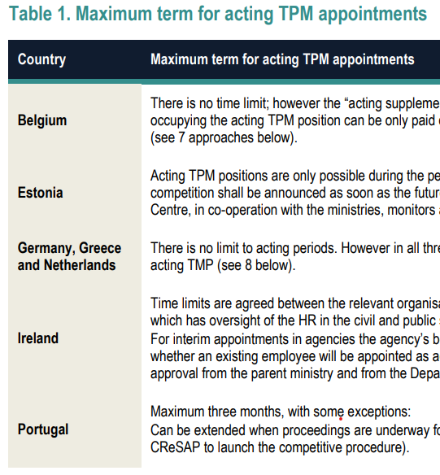
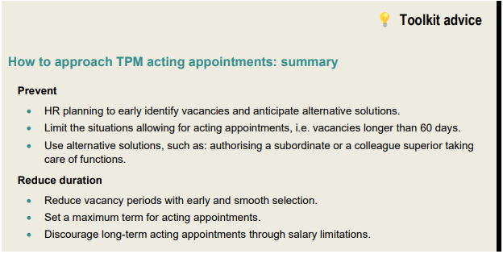
Acting appointments (2)

Slide 74
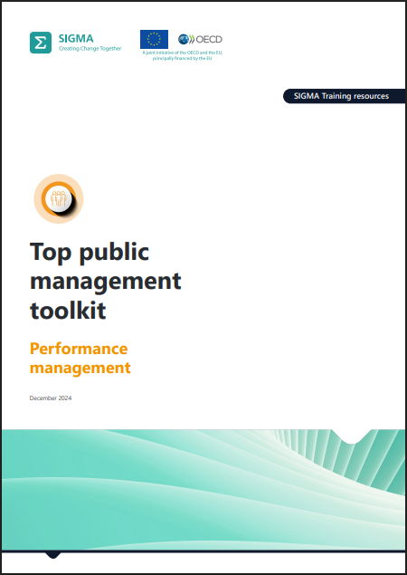
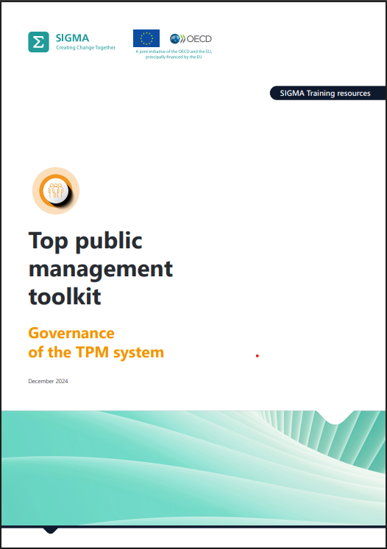
Booklets 5 and 8

Slide 75

Plans for the future
Constant update of the Toolkit
(new, relevant examples)
Corrections where needed
(experts’ work)
New booklets:
  “Training and development of TPM”
  “TPM Ethics/codes of conduct” (!)
  “Creating a TPM system”
  “TPM operating environment”
Bilateral work with the administrations

Slide 76
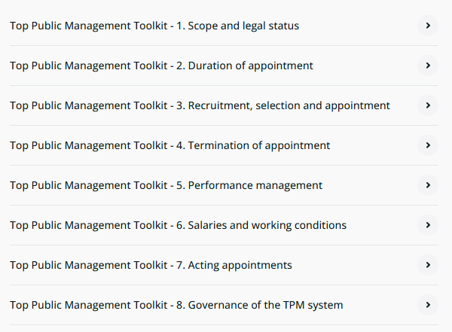

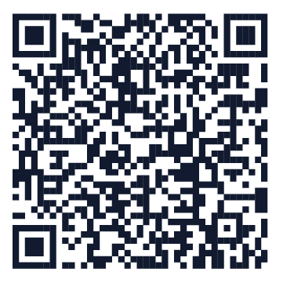
Top Public Management Toolkit - Available online
www.sigmaweb.org

Slide 77

New sigmaweb.org
Explore our
new website
Powerful search
Quickly find the content and resources you need.
Fully responsive design
Seamless experience on any device (desktop, tablet or phone).

Slide 78





Find out more about SIGMA
www.sigmaweb.org
www.par-portal.sigmaweb.org
www.linkedin.com/company/sigma-programme
sigmaweb@oecd.org

Slide 80

Presented by
Gracia Vara Arribas, Head of the European CAF Resource Centre
Tihana Puzic, Deputy Head of the European CAF Resource Centre
A Tradition of Excellence,
a Future of Innovation:
EUPAN & EIPA Partnership
30.September 2025
Notes:
80

Slide 81


A Tradition of Excellence, a Future of Innovation
EUPAN & EIPA Partnership

Slide 82

European Institute of Public Administration
EIPA was created in 1981 on the occasion of the first European Council held in Maastricht.
Supported by the EU Member States and the European Commission.
Cross-national and cross-institutional comparative, analytical perspectives on EU policies.
Longest-standing experts in EU public affairs.
Locations
Maastricht, The Netherlands - Headquarters
Luxembourg - European Centre for Judges and Lawyers (ECJL)

Slide 83

EUPAN & EIPA
Partnership since 1988
EIPA has been a partner of EUPAN providing scientific support and acting as a central point for dissemination of EUPAN's activities.
Policy to practice
Transforming EUPAN's strategic policy dialogue into concrete approcahes, comprehensive training programmes, and practical implementation guidance.
Shared strategic partnership within the Network and observer organisations
Mandated by EUPAN in 2000 EIPA is hosting the European CAF Resource Centre.

Slide 84




Danish Presidency Priorities & EIPA Strategic Link
EIPA's expertise directly supports the Danish Presidency's key agenda items through targeted training and capacity-building initiatives.
Secure Europe
AI and Digitalisation
Evolving dynamics in in defense and security procurement in Europe
Tailor made Data Protection and Cyber Security capacity building
Interdisciplinary perspectives to respond to the current and future impacts of AI on public life
Green Transition & Housing Projects
EU Enlargement Support
Specialised training in delivering strategy approaches in Housing initiatives and the future of the Green Deal
Direct reform assistance and tailored training programmes for Ukraine, Moldova, Armenia, Western Balkans build strong, European-standard administrative capacities.

Slide 85

Our Training Excellence
200+
5K+
Annual Courses
Annual Participants
Comprehensive programmes delivered each year
Civil servants trained across Europe
Core Training Topics
EU Law & Policies
Policy Design & EU Funds
Understanding European legislation, implementation strategies, and compliance frameworks for effective governance.
Evidence-based policy making, EU funding mechanisms.
Quality & Leadership
EU Presidency
Essential skills and strategies for navigating the challenges of an EU Presidency
CAF implementation, change management, and leadership development for senior civil servants.
Flexible delivery formats: In-person workshops, online learning modules, and bespoke programmes tailored to specific organisational needs> https://www.eipa.eu/courses/

Slide 86

European Public Sector Award - EPSA
Europe's Innovation Showcase
EPSA 2025-26 edition welcomes the submission of projects in three award categories:
Innovating Government, Governance and Policies
Investing in Infrastructure, Mobility and Energy
Delivering User-Centric Services at Subnational Level
Is your organisation driving change and shaping the future of public services? The 10th anniversary edition of the European Public Sector Awards (EPSA) is your chance to shine.
EPSA is Europe’s stage for public sector excellence – open to administrations at all levels of government.

Slide 87


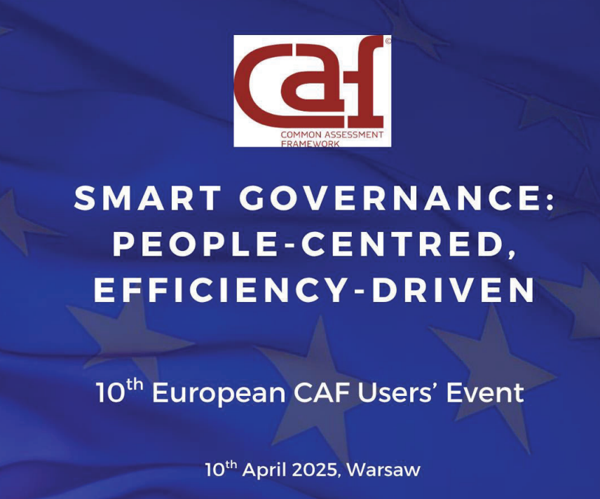

The CAF impact today
Notes:
At the end of the 1990s, quality management became an important issue for the public sector in the European Union. In order to coordinate their efforts and to start up a common European learning process, the EU Ministers responsible for public administration invited their Directors-General (DG) to promote exchanges and cooperation between the EU Member States and to develop common instruments in the field of quality management.
It was clear that there was a great need for European initiatives of this kind.
A first product of the cooperation among EU national experts was presented: the Common Assessment Framework (CAF), a real common European quality management instrument for the public sector, developed by the public sector.
By Implementing CAF2020, public sector organisations have the opportunity to take an internal approach towards improvement by involving both managers and employees. Organisations are improved through self-assessment based on the common European principles in three phases. CAF-Users can later apply for the Label “Effective CAF-User”. The CAF is free of charge and available to assist public sector organisations to improve their performance. It can be used in all parts of the public sector, and it applies to national/federal, regional and local levels. Although the CAF has been developed in a European context, it can be used in any public organisation around the world. The importance of CAF has been shown in the EUPACK projectiii and the “Toolkit for Quality of Public Administration“ iv both carried out by the European Commission with the support of EIPA. These researches prove that the use of CAF contributes to Public Administration Reforms and improves the performance of public sector organisations. Furthermore, studies of CAF-users show the impact of CAF on the improvement of services and the increasing of customer satisfaction.
The european commission introduced two years ago Co^Pact, to help develop a stronger european administrative space by promoting overarching principles of quality public administration and strngthening peer learning and cooperation between public administrations. BUILDING ON THIS:
This year the european commission has publishes a new toolbox for practitioners on quality of public administrations . It consists of webpages with useful information and illustrative practices as aplied in real situations. The centre piece is its 10 themes, each of which includes a general introduction to the subject that leads to different subthemes.
Public value and principels of good governance
Policy making implementation and innivation
Integrity transparency and anti corruption
Governance structures systems and coordination
Organisations: managing performance quality and people
Service design and delivery
Business environment
Quality justice systems
Public fiannce, procurement and eu cohesion policy funds
Modernising administrations: making positive change happen
j.1 becoming a digital administration
J.2 becoming a green public administration

Slide 88




CAF in Action
CAF Correspondents Meeting
Back-to-back with EUPAN working level meeting
Quality Conference 2026/27
Shared Learning
Inviting EUPAN members to share user-centric and quality management approaches.
Committed to a Future of Innovation
CAF Update survey
CAF Excellence Recognition Training

Slide 89

EUPAN and EIPA: Together for Better Public Administration
Our Tradition
CAF excellence, EPSA innovation awards, and four decades of trusted partnership building stronger European governance.
Our Future
Digital transformation, green transition, social resilience, and inclusive public administrations ready for tomorrow's challenges.
With EUPAN and the rotating presidencies, EIPA delivers world-class expertise, transformative training, and cutting-edge innovation to shape the future of European governance.

Slide 90

Time to team up

Slide 92
Thank you for participating in the Danish Presidency of EUPAN
September 2025

