Slide 1
Welcome to the Danish Presidency of EUPAN
September 2025

Slide 4
Introduction to the Danish Central Administration
September 2025

Slide 5
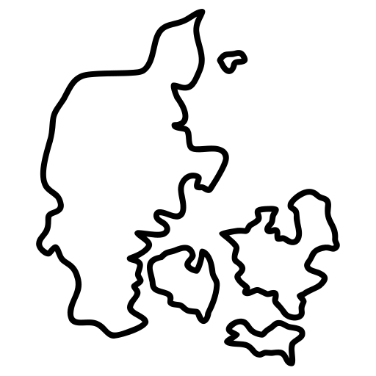


Content
Part 1: The Danish Central Administration
The Danish Central Administration
Part 2: Current Agendas
Part 3: Focus Areas of the Danish EUPAN-Presidency

Slide 6
Part 1: The Danish Central Administration

Slide 7
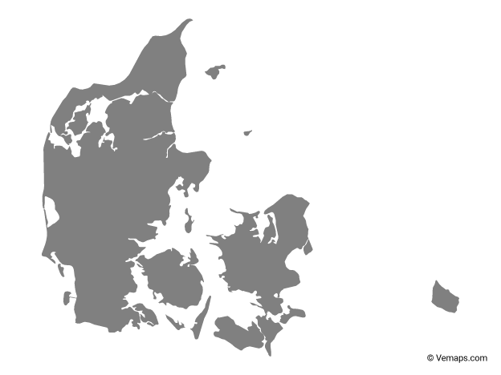


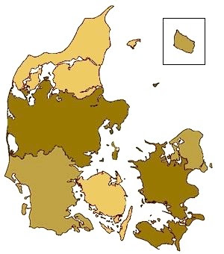


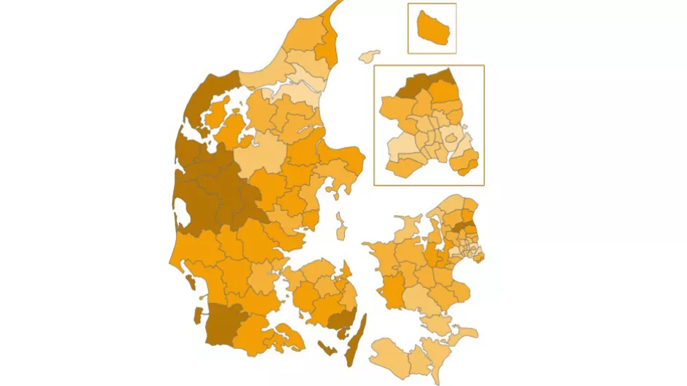


Administrative layers in the Danish public administration
The Danish Central Administration
Current Agendas
Focus Areas of the Danish EUPAN-Presidency
National
23 ministeries
Regional
5 regions → 4 regions
Municipal
98 municipalities

Slide 8


The Danish central administration
The Danish Central Administration
Current Agendas
Focus Areas of the Danish EUPAN-Presidency
Departments
Secretariat of the minister
Assist and advice the minister
Policy and press management
Political level
Minister
Permanent
Secretary
Deputy Permanent Secretary
Agencies
Implementation of legislation
Operation of authorities and institutions
Executive and technical
Administrative level
Head of Division
Administrative Officer

Slide 9


The Danish central government has a strong culture of consensus and dialogue
The Danish Central Administration
Current Agendas
Focus Areas of the Danish EUPAN-Presidency
Minority governments
Strong tradition of minority governments and negotiated consensus
Cross-party agreements
Culture of broad cross-party agreements shaping major policies

Slide 10



The Danish central administration is highly digitalised and has a high degree of trust
The Danish Central Administration
Current Agendas
Focus Areas of the Danish EUPAN-Presidency
Denmark ranks #2 at OECD’s Digital Government Index
Denmark has one of the highest levels of trust in government and public services
Sources: https://www.oecd.org/en/publications/government-at-a-glance-2025_0efd0bcd-en/full-report/digital-government-index_1edec44e.html
https://www.oecd.org/en/publications/oecd-survey-on-drivers-of-trust-in-public-institutions-2024-results_9a20554b-en/full-report/trust-in-day-to-day-interactions-with-public-institutions_7d0e07b0.html#chapter-d1e3756-d8dfe289b0

Slide 11



Denmark has a unique employment model for civil servants
The Danish Central Administration
Current Agendas
Focus Areas of the Danish EUPAN-Presidency
Negotiation of collective agreements
Working conditions and salaries

Slide 12
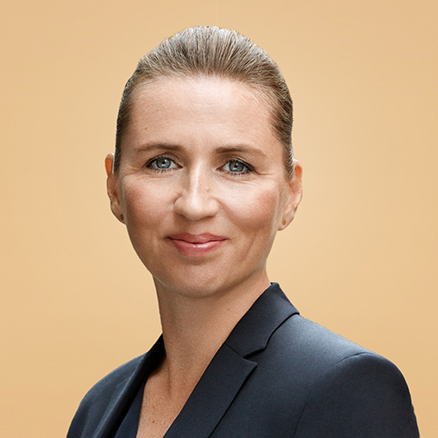
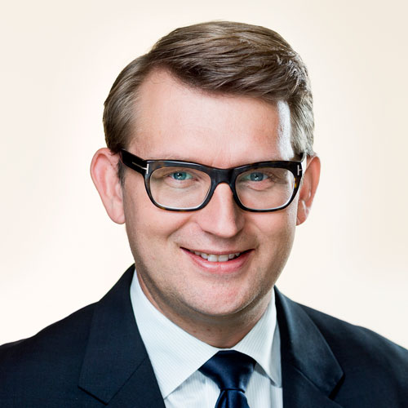
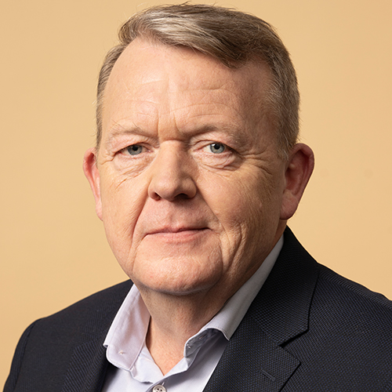
Denmark currently has a historically broad-coalition majority government
The Danish Central Administration
Current Agendas
Focus Areas of the Danish EUPAN-Presidency
Mette Frederiksen
Prime minister, chairwoman of The Social Democrats
Troels Lund Poulsen
Deputy prime minister, minister of defence, chairman of The Liberal Party
Lars Løkke Rasmussen
Minister of foreign affairs, chairman of The Moderates

Slide 13
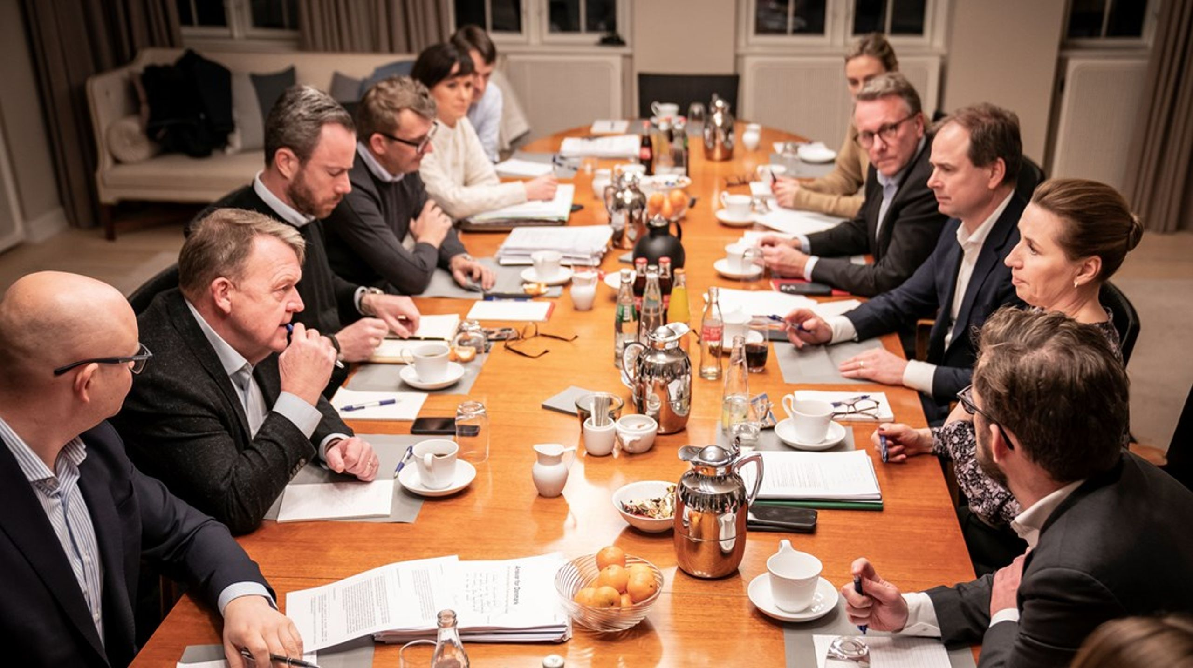


The Danish Central Administration
Current Agendas
Focus Areas of the Danish EUPAN-Presidency
Major political decisions are treated in interministerial committees
Coordination committee
Economic coordination committee
13

Slide 14

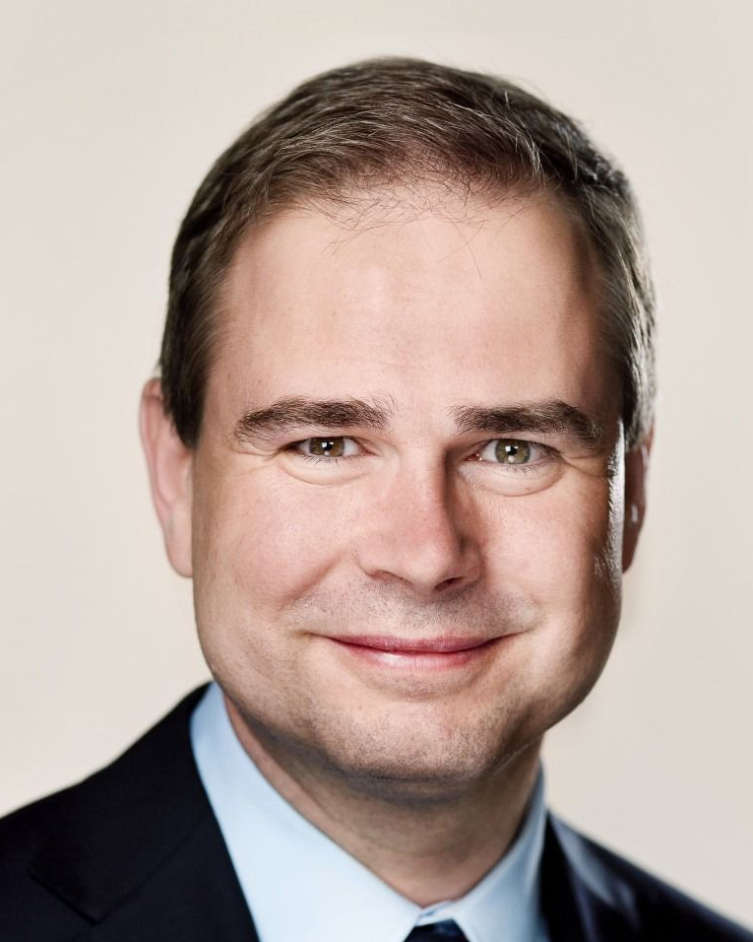



The Danish Ministry of Finance plays a key role in the Danish administrative system
The Danish Central Administration
Current Agendas
Focus Areas of the Danish EUPAN-Presidency
Danish minister of Finance
Interministerial coordination
Financial management
Back-office administration
Nikolaj Wammen
IT-management

Slide 15




Organisational chart of the Danish Ministry of Finance
The Danish Central Administration
Current Agendas
Focus Areas of the Danish EUPAN-Presidency
Agency for Governmental IT Services

Slide 16
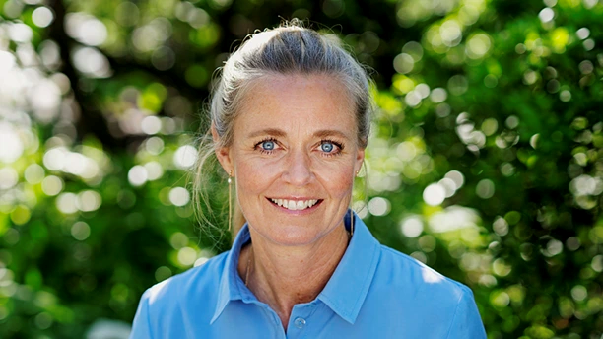
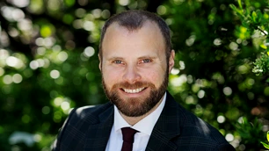
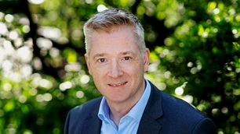
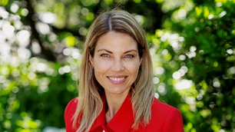
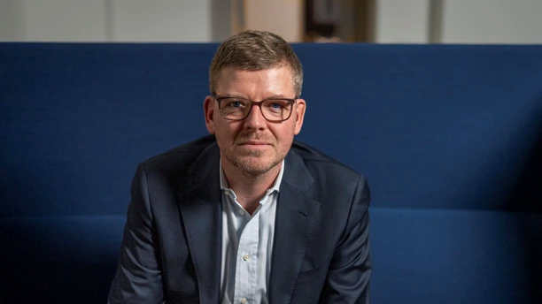
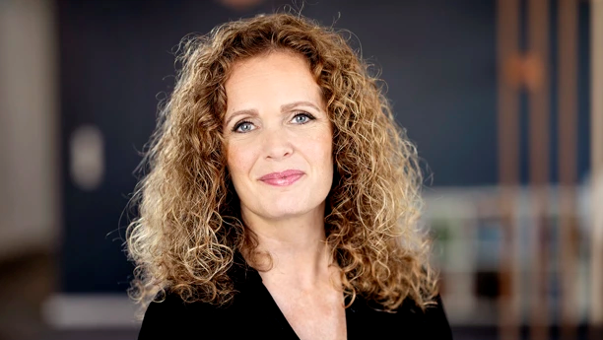
Agency for Public Finance and Management and the Danish Employee and Competence Agency
The Danish Central Administration
Current Agendas
Focus Areas of the Danish EUPAN-Presidency
Line Nørbæk
Thomas Stoltenberg-Gloy
Simon Schulian
Caroline Kirk
Christian Liebing
Tina Feldt Jessing
Director General
Deputy Director General
Deputy Director General
Deputy Director General
Director General
Deputy Director General
Executive responsibility
Procurement and policy
IT-systems
Organisational matters
Executive responsibility
Deputy-executive responsibility

Slide 17
Part 2: Current agendas

Slide 18



Our agencies are directly or indirectly involved in several major agendas in Denmark
The Danish Central Administration
Current Agendas
Focus Areas of the Danish EUPAN-Presidency
1. increasing cyber security with open-source and cloud solutions
2. Increased use of artificial intelligence
3. Ensuring a strong future for Danish economy

Slide 19



The Danish Central Administration
Current Agendas
Focus Areas of the Danish EUPAN-Presidency
1. Increasing cyber security with open-source and cloud solutions
Security of supply in IT
From single supplier reliance to open-source
Cloud services
Ensuring a safe and necessary transition
19

Slide 20


The Danish Central Administration
Current Agendas
Focus Areas of the Danish EUPAN-Presidency
2. The use of artificial intelligence is increasing
Artificial intelligence
A continuous priority
Chatbots
Embracing new opportunities
20

Slide 21
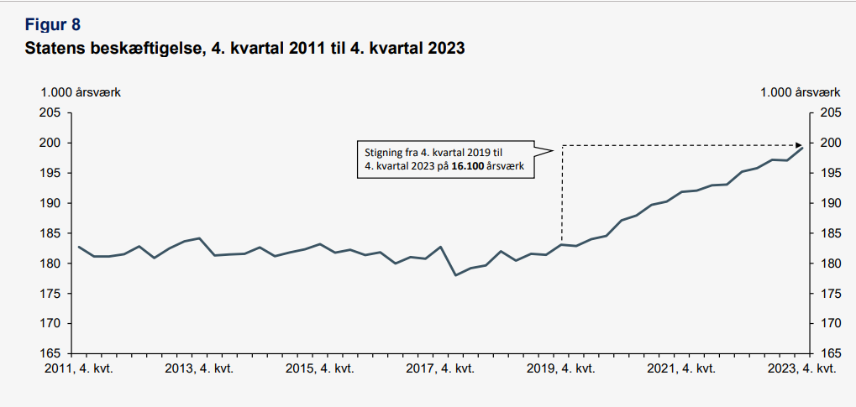
3. Ensuring a strong future for the Danish economy
The Danish Central Administration
Current Agendas
Focus Areas of the Danish EUPAN-Presidency
Danish Economy is strong, but not impervious
State Employment, Q4 2011 to Q4 2023
1.000 FTEs
1.000 FTEs
1.000 FTEs reduction in 2025
6.500 FTEs reduction by 2030
16.100 FTE increase from 2019-2023
Source: Appendiks - Udviklingen i statsligt ansatte, 2025 - Finansministeriet

Slide 22
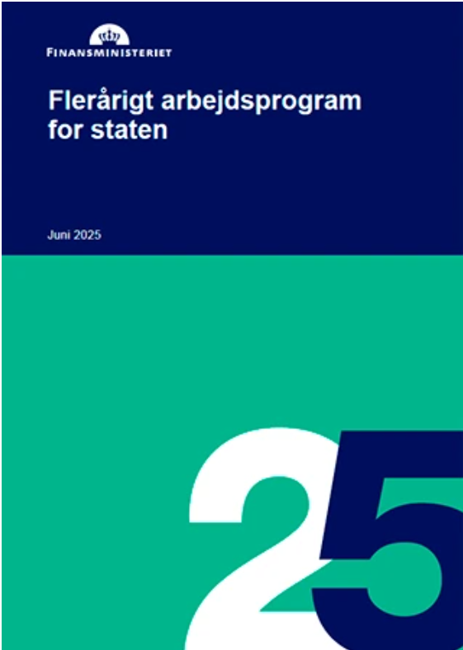



The Danish Central Administration
Current Agendas
Focus Areas of the Danish EUPAN-Presidency
Comprehensive multi-year work program for the state sector
Reducing costs of €736 mio by 2030 equivalent to 6,500 FTEs
Ministries must submit plans for managing the 2026 savings
Implementation of measures to reduce administrative costs

Slide 23
Part 3: Focus Areas of the Danish EUPAN-Presidency

Slide 24



The Danish Central Administration
Current Agendas
Focus Areas of the Danish EUPAN-Presidency
We have selected three areas of focus during our presidency
Artificial Intelligence in Public Administration
Strengthening Public Leadership
IT Governance and Management

Slide 25
Questions and comments

Slide 26
Thank you

Slide 28
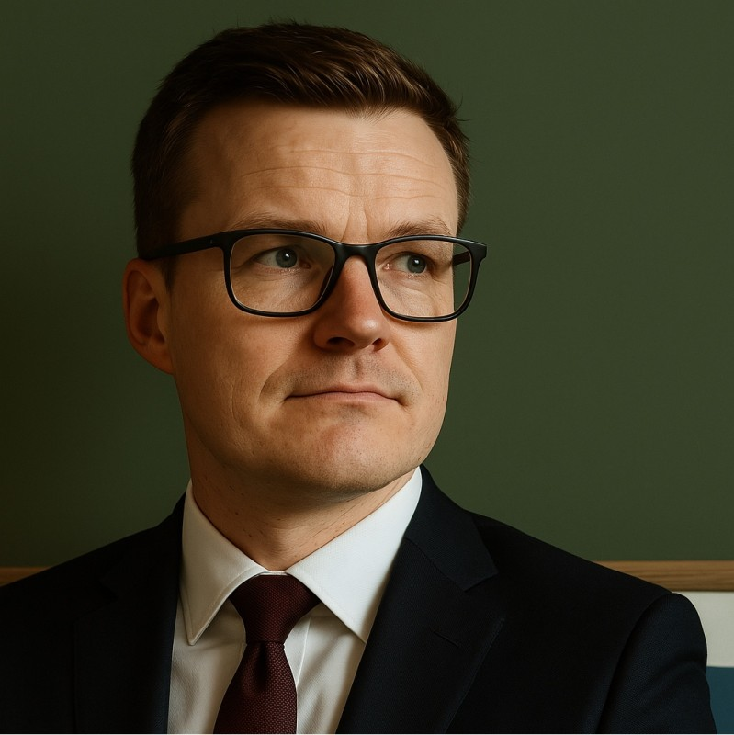

Brian Arreborg Hansen - Agency for Public Finance and Management (Økonomistyrelsen)

Slide 29

What is ”Økonomistyrelsen” ?
Government accounts
Procurement
Digital solutions
IT and financial management
Advisory and analysis
Competence development
Prerequisites for deploying AI in ways that create value across the public sector

Slide 30
The Automation Agenda of Økonomistyrelsen

Slide 31
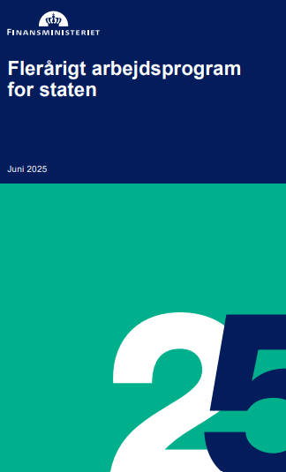




Why focus on AI
Free up resources: AI automates routine tasks and frees up time for core tasks in the state.
Efficiency: AI creates a more modern, data-driven, and efficient public sector.
Support savings: AI contributes to achieving the goal of 5.5 billion DKK in administrative savings by 2030.
Responsible digitalization: AI is implemented responsibly and supports quality, transparency, and trust.

Slide 32


Different types of AI – different use cases
Generative AI
Writing text (emails, reports, summaries)
Creating images, code, or presentations
Answering open-ended questions
Supporting creativity and brainstorming
Automating complex language tasks
Rule-based Machine Learning
Predicting outcomes (e.g. risk scores, demand forecasting)
Detecting patterns in structured data
Classifying emails, invoices, or documents
Automating decisions based on clear rules
Monitoring for anomalies or fraud

Slide 33
AI-driven automation initiatives cases from the Danish central governmen

Slide 34






Automation Projects Led by Økonomistyrelsen
Samarbejds- projekter
Automatisering i sagsbehandlingen
Samarbejds- projekter
Automatisering i sagsbehandlingen
Control- ling
UNSPSC codes
Triage
GDPR- scanner
Collaborative
projects
Automation in administrative
case processing
Building cases
Draft
message

Slide 35



The Three Principles Behind Our Sucess
Focus on Buisness Value
Automation saves time and money with a rapid return on investment
Connected Technology
AI solutions are integrated directly into existing systems
Rooted in People
Employees and leadership are invovled every step of the way to ensure the soluions are adopted
Notes:
Her er tre hovedpointer om, hvorfor projekterne er blevet en succes:
Betydelige effektiviseringsgevinster og hurtig tilbagebetaling
Automatiseringsløsningerne har reduceret tidsforbruget markant – f.eks. har Skattestyrelsen sparet 6 årsværk, og Nævnenes Hus har sparet 4 årsværk.
Udviklingsomkostningerne er i de fleste projekter blevet tjent hjem inden for det første år efter implementering.
Institutionerne oplever en mere effektiv og ensartet sagsbehandling, hvilket øger kvaliteten og brugertilfredsheden.
Tæt integration med eksisterende systemer
Løsningerne er designet til at fungere inden for eksisterende fagsystemer, hvilket sikrer høj brugervenlighed og let adoption blandt medarbejderne.
Projekterne har haft fokus på fleksibel arkitektur og API-integrationer, hvilket har gjort det lettere at skalere løsningerne.
Ved at bygge videre på eksisterende teknologier og data har løsningerne kunnet implementeres hurtigt uden større omstruktureringer.
Stærk organisatorisk forankring og brugerinvolvering
Løbende test og inddragelse af medarbejdere har sikret, at løsningerne er tilpasset konkrete forretningsbehov.
Ledelsesforankring og strategisk prioritering har været afgørende for, at projekterne har fået de nødvendige ressourcer.
Fokus på forankring efter idriftsættelse har sikret, at løsningerne bliver brugt i praksis og ikke blot forbliver pilotprojekter.
Disse tre faktorer – økonomisk gevinst, teknisk integration og organisatorisk forankring – har været nøglen til, at projekterne er blevet en succes.

Slide 36



What Challenged the Projects - The Three C’s
Capacity shortage
Difficult to find time and personnel for development and operations
Complexity
Requirements for system integration and data quality
Coordination Needs
The necessity for tight management across different actors

Slide 37

Case: Draft Message

Slide 38

Automation project with Danish Property Assessment Agency: AI-Generated Case Messages
Automating the preparation of messages for homeowners by generating draft messages based on previous decisions and case notes
The Danish Agency for Public Finance and Management has developed an ML-based text generator that assists caseworkers in drafting messages.
Machine learning is used to analyze past case notes and tailor messages in real time
Expected time savings corresponding to 7 FTEs and increased consistency and quality in communication
The ML model reviews previous decisions and case notes to identify patterns and relevant phrasing.
The caseworker adjusts and approves the draft before it is sent to the homeowner.
The system creates a draft tailored to the specific case on previous similar decisions.
Notes:
Talenoter
Projektet var et samarbejde mellem Økonomistyrelsen og Nævnenes Hus
Løsningen er integreret med Klageportalen, og er idriftsat Q3 2023. Fuld udrulning af integrationen forventes Q1 2024.
Klageportalen anvendes af 4 ud af 19 klagenævn i Nævnenes Hus, men det forventes, at der bliver tilknyttet yderligere klagenævn, som derfor også vil bruge løsningen.
Før implementering af løsningen anvendte de 4 klagenævn ca. 9 årsværk på screening af dokumenter fra sager i Klageportalen.
Nævnenes Hus forventer at effektivisere screeningsprocessen med mindst 50% for de fire klagenævn, som er bruger Klageportalen
Derudover forventes det, at klagesager behandles hurtigere og med reduceret liggetid.
Nævnenes Hus forventer at udvikle flere integrationer og anvendelser til GDPR-scanneren, herunder scanning af fildrev og integration til ESDH-system.
Desuden forventes der at blive udviklet integrationer til
Afgørelsesportalen, hvor afgørelser skal anonymiseres inden de offentliggøres
ESDH-system (Public 360)
Scanning af sagsbehandleres fildrev for dokumenter med personfølsomme oplysninger til journalisering

Slide 39










What Does the Solution do?
Case worker
Solution
1. The caseworker writes a note with a professional assesment of the case and inserts it into our solution
2. Finding an archived case where the case circumstances and case notes are most similar to the current case
3. Finding the corresponding historical justification text for the case
6. The caseworker reads and adjusts the draft before it is sent to the homeowner
5. The solution returns a draft justification with a number of annotations along with a validation text
4. Information specific to the archived case is redacted or replaced with information from the current note

Slide 40
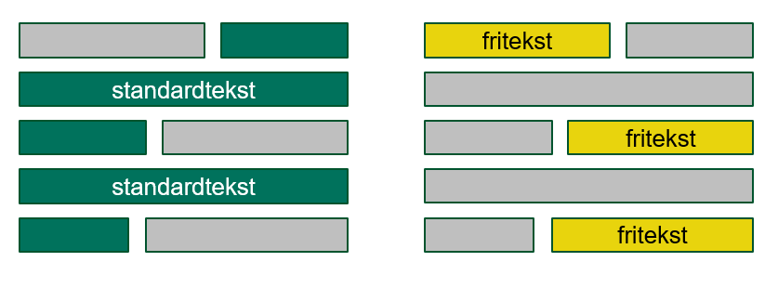
4. Identifying overlapping standard text
5. Proposing additional free text based on the current case note and the standard text
free text
standard text
free text
standard text
free text

Slide 41

Case: GDPR-Scanner

Slide 42

Automation Project with Danish Appeals Boards AuthorityHas Developed a GDPR-scanner for Identifying Personally Identifiable Information
The project was about automating screening for personally identifiable information
Økonomistyrelsen developed a GDPR-scanner that combines machine learning with pattern matching to identify 9 types of personal data in documents
In the short term, the solution is expected to produce efficiency gains equivalent to 4 FTEs
As more boards are connected, the benefits are expected to increase
Over 100,000 documents are received annually
ML-models identify personal data
Caseworker decides if the documents can be shared
Notes:
Talenoter
Projektet var et samarbejde mellem Økonomistyrelsen og Nævnenes Hus
Løsningen er integreret med Klageportalen, og er idriftsat Q3 2023. Fuld udrulning af integrationen forventes Q1 2024.
Klageportalen anvendes af 4 ud af 19 klagenævn i Nævnenes Hus, men det forventes, at der bliver tilknyttet yderligere klagenævn, som derfor også vil bruge løsningen.
Før implementering af løsningen anvendte de 4 klagenævn ca. 9 årsværk på screening af dokumenter fra sager i Klageportalen.
Nævnenes Hus forventer at effektivisere screeningsprocessen med mindst 50% for de fire klagenævn, som er bruger Klageportalen
Derudover forventes det, at klagesager behandles hurtigere og med reduceret liggetid.
Nævnenes Hus forventer at udvikle flere integrationer og anvendelser til GDPR-scanneren, herunder scanning af fildrev og integration til ESDH-system.
Desuden forventes der at blive udviklet integrationer til
Afgørelsesportalen, hvor afgørelser skal anonymiseres inden de offentliggøres
ESDH-system (Public 360)
Scanning af sagsbehandleres fildrev for dokumenter med personfølsomme oplysninger til journalisering

Slide 43





NH: CSA Developed an Automated Personal-Data Screening Tool for Nævnenes Hus
Responsbilities of Nævnenes Hus
Target State of the Solution
Reception of complaints
Reduction in complaint processing
time and case backlog
Complaints handling
High accuracy in identifying personal data
Document sharing with involving parties
to the case
Categorization of personal data
Preparation of documents for tribunal proceedings
Increase employee well-being
Publications of case decisions
Future-proof operations and further development

Slide 44

Case: Message Triage

Slide 45




Our Project on Tax Administration has Resulted in Inquires to Skattestyrelsen Now Being Triaged by Machine Learning
Taxpayers
The purpose of the project was to automate triage of inquires from taxpayers
Økonomistyrelsen and Udviklings- og Forenklingsstyrelsen have developed a machine learning-based tool that reduces the need for manual triage
The solution was deployed in Q4 20203 and is expected to free up more than half of the manual time spent on the task, corresponding to approximately 6 FTEs
300,000+ messages received annually
an ML-model allocates them to units
Advisors and Caseworkers
Notes:
Talenoter
Projektet var et samarbejdsprojekt mellem SKTST, UFST og ØS
Løsningen blev udviklet, produktionslagt og forretningsimplementeret over en periode på ca. 10 måneder og har kørt stabilt i drift siden oktober 2023
Tidligere brugte de mest erfarne medarbejdere i vejledningen en stor del af deres tid på at fordele henvendelser fra skatteydere mellem kontorer og ud til vejledere
I dag sender løsningen automatisk henvendelser ud til vejledere
Med løsningen bliver de erfarne medarbejderes ekspertise kun inddraget til visitering, når modellen visiterer forkert
Det frigiver en stor mængde tid, som i stedet kan bruges på vejledningsopgaven
Samlet frigiver løsningen forventet 6 ÅV
Løsningen er indledningsvist opsat til vejledningsområdet, men der er desuden mulighed for at udvide den til sagsbehandlingsområderne på længere sigt
Udvidelse kan fordoble gevinsten

Slide 46


A Revised Process
Message flow navigator (”Slusemester”) reviews all inquires before the agent receives them
Replies to taxpayers
Message Flow
Navigator
Agent
The agent receives all inquires and consults with message flow navigator for assistance with difficulties
Wrong navigation or wrong skill
Message Flow
Navigator
Agent
Agent
Replies to taxpayers
Notes:
KENNETH

Slide 47
How do we transition from successful pilots to large-scale solutions?

Slide 48



Specific Challenges Regarding Scaling
Integrations
Each new system requires separate customization
Institutions
Have different processes and needs
Infrastructure
Technical solutions must be adapted to local IT environments

Slide 49
GenAI in The Danish Agency for Public Finance and Management

Slide 50



Typical barriers for GenAI-use
Legal
What are we allowed to do?
Tecnical
How do we do it?
Business-related
How do we use it?

Slide 51



Requiaments
Compliance:
Secure solution
Data control
Traffic control
Compliant with public laws such as GDPR
Usability:
Easy and specialized
Appropiate for users with no generative AI experience
Differentiate users regarding document access
Technical
up to speed
Little technical debt
Easily Updated
Support and documentation

Slide 52




Business case for ØSA
Increased security and compliance
Blocking external requests
Control stored uploaded data
Comply with GDPR and data laws
Specialization
Upload own company documents
Specialize the chatbot to use-cases common in the office
Granulated acces to documents based on Microsoft ID
Technically managable
Build on top of open sourced codebase
Deployed on cloud platform – managed infrastructure

Slide 53

Use cases for ØSA
Navigate rules and procedures quickly and efficiently
Rewrite documents to fit standardized ministry templates
Summarize long documents
Generate drafts for documents based on unstructured information
Onboarding of new employees
And many more......

Slide 54
Key elements in ØSA
1. General Chat
2. Special Chats
Custom AI chats built around specific documents or use cases (e.g. contracts, legislation). These can be created and managed by users or teams, with access control.
3. Personal Knowledge Bank
Users can upload their own documents (Word, PDF, PowerPoint), allowing ØSA to answer questions based on personal content.
A GPT-based assistant for broad knowledge queries, sparring, and support across topics. It acts as an internal AI chatbot.

Slide 55
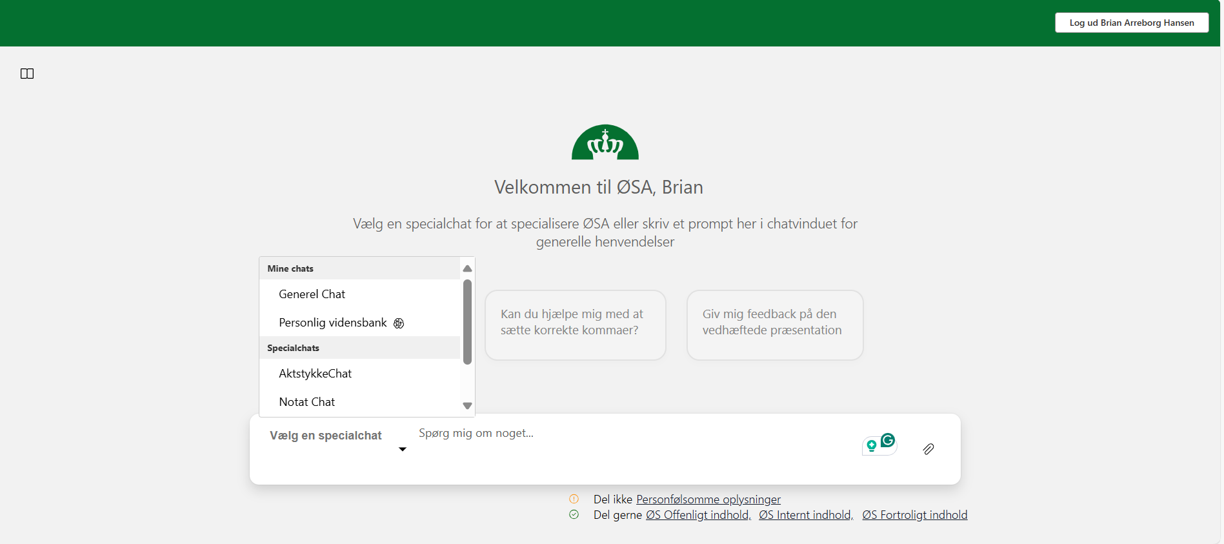
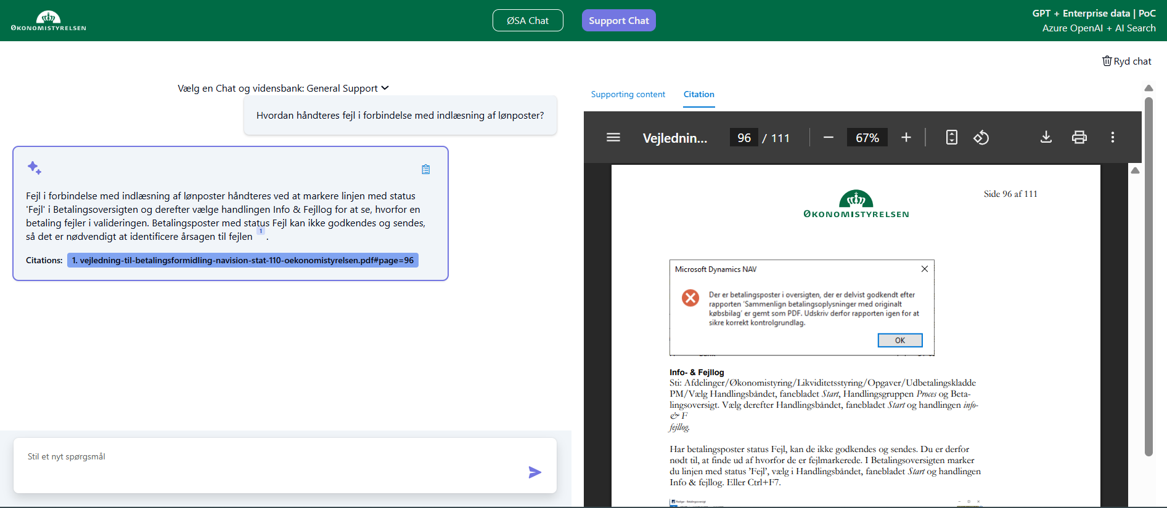
ØSA Version 2.0

Slide 56
Support Chat – A killer use-case

Slide 57
Lessons learnd
AI needs organizational anchoring
Clear guidelines are essential
Human validation is critical
GenAI is broadly applicable — not just for tech experts
Security and compliance must be in place
Small gains create big value

Slide 58

ØSA og CO-pilot
ØSA
Inexpensive
Custom-tailored
Vendor-independent
Co-pilot
Integrated into the Office suite
Access to all our documents
Notes:
ØSA er kendetegnet ved at være en billig, specialtilpasset og leverandøruafhængig løsning, hvilket giver fleksibilitet og omkostningseffektivitet.
Co-pilot er integreret direkte i Office-pakken, hvilket betyder, at brugerne får nem adgang til avancerede funktioner uden at skulle skifte platform. Den har også adgang til alle vores dokumenter, hvilket sikrer en effektiv og sammenhængende arbejdsproces.

Slide 59

Brian Arreborg Hansen
BRAHA@OES.DK +45 40 31 36 58

Slide 61

EUPAN survey on IT Management: WL Meeting
NB. Work in progress conclusions for EUPAN WL Meeting in September 2025.
Final conclusions will be available before the DG Meeting in December 2025.

Slide 62
Survey background and method
Background: Government digitalization is a key priority for the European Commission and most EU member states, but it is often characterized by high costs, complexity, and risks. Effective governance and professional IT management are therefore key to successful government digitalization.
Purpose of study: The purpose of this survey is to investigate the extent to which the management of existing IT systems, IT projects and existing digital infrastructure within ministries and government agencies is centralized and how it is coordinated in the EUPAN member countries.
Survey themes: Digital infrastructure, IT projects, IT systems, Autonomy, Shared information, and trends over time.
Collection period: Data collected via questionnaire from June to August 2025
Response rate: 89,5%
26 of 27 member states submitted their response
7 of 10 observer countries submitted their response
The European Commission also submitted their response
Notes:
Tekst og billede

Slide 63
Limitations of our study
While we believe that the high response rate makes this study particularly useful in providing an overview of experiences, challenges and trends of the governance and management of government IT in the EU, we also believe that there it is important to keep the following limitations of the study in mind:
In the survey, we asks a set of general questions to study structures and coordination mechanisms across very different types of government systems, traditions and structures. The general nature of our questions may homogenize the answers and thus hide smaller variances and nuances regarding countries` different approaches to IT management.
The general nature of the survey questions allows for interpretative flexibility, meaning that countries may interpret questions differently depending on individual and country specific perspectives.
With these limitations in mind, we argue that the data is appropriate for a general overview and discussion of experiences and trends in IT management across EUPAN member states.

Slide 64
The Danish IT governance journey in milestones
1960s: Early adoption of IT infrastructure in Danish Government for tasks such as tax calculation, population register tasks, and statistical calculations.
2000s : Development of IT infrastructure covering most areas of public sector administration.
2011: Danish government establish a Governmental IT Council and a central model for IT project management.
2018: Danish government establish a model for IT system portfolio management and expands the IT Councils mandate to include reviews of how government authorities manage their portfolio of existing IT systems.
Digital infrastructure
IT project management
IT portfolio management

Slide 65
Key findings 1/4
The survey identifies a general pattern of centralization in the governance of IT management across EUPAN member states:
A clear majority of countries has some level of centrally provided digital infrastructure (88% or 29 of 33)
A clear majority of countries have a degree of central coordination of management of IT projects (79% or 27 of 34 )
Two-thirds of countries have a degree of central management of IT systems. (67% or 22 of 33)
Central coordination located in a specific ministry (Digitalization, Finance or other) or a specific digitalization agency
Most countries show a combination of both binding central regulations and standards/models for certain areas but also softer forms of coordination (white papers/guidance, dialogue) in other areas.
Existing digital infrastructure | Digital infrastructure refers to the fundamental technological systems and services that enable electronic communication, data processing and storing, and information exchange within the central government.
IT projects | An IT project is understood as a temporary endeavor undertaken to create a new IT system or a significant adaptation of an existing IT system. IT systems conceptually cover IT applications, IT solutions, IT infrastructure and the like.
Existing IT systems | Existing IT systems is understood as the total portfolio of IT systems or in other words the total collection of IT systems within a ministry, central governmental agency or other body at central government level. IT systems conceptually cover IT applications, IT solutions, IT infrastructure and the like.

Slide 66
Key findings 2/4
Management of existing central governance of IT systems
A clear majority of EUPAN Member states have binding regulations for IT finance and IT security. For application maintenance and especially the management of in-/outsourcing binding regulations are less common
A little less than two thirds of all countries rely on softer coordination mechanisms for IT systems and one third neither regulate or support IT systems
Some countries use a combination of both binding regulation/standards and soft coordination via dialogue and guidance
Coordination of existing digital infrastructure
Almost all countries support ministries and agencies by providing common public digital services for budgeting, accounting, payroll etc. and providing common standards, architecture and infrastructure for data exchange with some exceptions.
Most countries has more than one ministry/agency providing digital infrastructure; 8 countries have centralized this in one single ministry/agency

Slide 67
Key findings 3/4
Management of IT projects
About half of all countries have binding regulations on how to manage IT projects and have project phase-gates for approval or review of IT projects.
Regarding risk assessment and reporting of IT projects, binding regulations are less common, and we see a prevalence of recommended models and standards as key coordination mechanisms.
Some countries combine both binding regulations and softer forms of coordination.
A small number of countries do not have any central coordination for these four dimensions of IT project governance.
Coordination across government levels
Central government coordination affects other government levels to different degrees.
In only two countries, rules and standards for IT governance are also binding for other government levels.
In most countries, central government coordination affects other government levels to a significant degree or partially.
In about one-fifth of the countries, other government levels are not at all affected by central government coordination.

Slide 68
Key findings 4/4
Despite the substantial degree of central coordination efforts, the autonomy of individual ministries and agencies regarding IT management is still rather high. Most countries report full autonomy in decisions on procurement and on software licenses for IT systems. Somewhat less autonomy is reported for decisions on IT security and IT system development (here partial autonomy predominates).
About 70% of EUPAN countries have government-wide information on the number of existing IT systems and running IT projects as well as their budgets and expenses. Five countries report fully centralized information, whereas in most other countries partially centralized information is available.
Level of central coordination vs. level of shared information and transparency
Although not strong, there is a correlation between the level of central coordination and the level of shared information and transparency: the more central coordination, the higher the level of shared information and transparency.
Level of central coordination vs. level autonomy for management of IT
There is almost no correlation between the level of central coordination on existing IT systems and IT projects and the level of autonomy for management of IT systems in ministries and government agencies.

Slide 69
Perspective on the future of IT management in EUPAN
The survey shows that EUPAN countries tend toward similar forms of ICT governance overall — perhaps more so than would be expected in other government fields, making digitalization a more centrally coordinated policy area.
Overall, there are substantial country variations, with some having a rather decentralized governance of IT, and other countries being more centralized.
The survey confirms a clear tendency toward increasing centralization of IT governance expected over the next five years.
Nearly all countries agree that IT governance will become a greater priority in the future and that it will become more transparent, with government-wide information on existing IT systems, running IT projects, and IT expenses.

Slide 70
Final thought from a Danish perspective
From a Danish perspective, we have experienced the professionalization of ICT governance as a journey starting with the digital infrastructure leading to focus on managing the development of new IT projects to finally focus more on the overall portfolio of existing as well as emerging IT systems.
Our study show that EUPAN countries have more focus on digital infrastructure than projects and finally focus the least on the overall portfolio of IT systems.
Digital infrastructure
IT project management
IT portfolio management

Slide 71
Questions to the audience
How far are you in professionalizing IT Management in your country, and do you recognize the steps towards focus on infrastructure → projects → systems?
What are your main challenges currently in relation to IT Management from your national perspective?
What issues did you have in collecting data for the survey, and how does that reflect issues in comparing IT management across different countries in general?
What do you think is the most important learning outcomes from our study and from comparing IT Management in general across countries?

Slide 72


Acknowledgement
The preparation of this questionnaire would not have been possible without the invaluable help we have received from:
Gerhard Hammerschmid Professor of Public and Financial Management Centre for Digital Governance Hertie School The University of Governance in Berlin
Carsten Greve Professor of Public Management and Governance Department of Organization Copenhagen Business School

Slide 73
Thank you to all EUPAN countries for participating in the survey!
NB. Work in progress conclusions for EUPAN WL Meeting in September 2025.
Final conclusions will be available before the DG Meeting in December 2025.

Slide 75


Preliminary results from the survey on leadership values and development
September 2025

Slide 76
Work satisfaction based on leader performance
”All in all I’m satisfied with my work”
”How good of a job do you think your closest leader performs?”

Slide 77
Why Strengthening Public Leadership?
The importance of leadership
Current challenges
Sharing inspiration
Good leadership makes a difference
Good leadership is central in tackling an adversity of challenges
A plethora of challenges faces Europe
Some individual, but many across the continent
Sharing inspiration and experience is a central tool to manage these challenges
The Danish PLUS program
Inspiration and continued development
Strengthening public leadership = sharing experiences and bettering public leadership across EUPAN

Slide 78
Why Strengthening Public Leadership?
The importance of leadership
Current challenges
Sharing inspiration
Good leadership makes a difference
Good leadership is central in tackling an adversity of challenges
A plethora of challenges faces Europe
Some individual, but many across the continent
Sharing inspiration and experience is a central tool to manage these challenges
The Danish PLUS program
Inspiration and continued development
Strengthening public leadership = sharing experiences and bettering public leadership across EUPAN

Slide 79
Why Strengthening Public Leadership?
The importance of leadership
Current challenges
Sharing inspiration
Good leadership makes a difference
Good leadership is central in tackling an adversity of challenges
A plethora of challenges faces Europe
Some individual, but many across the continent
Sharing inspiration and experience is a central tool to manage these challenges
Inspiration and continued development
Strengthening public leadership = sharing experiences and bettering public leadership across EUPAN
The Danish PLUS program

Slide 80
Preliminary results on leadership values

Slide 81


Challenges addressed
Strengthening recruitment and retention
Ensuring integrity and compliance
Adaptability
Managing complexity
Modernization and digitalization

Slide 82

Key values
Core civil service values
Leadership competencies
Transparency
Neutrality
Rule of law
Public interest
Integrity
Cooperation
Innovation
Performance focus
Psychological security
Inclusiveness

Slide 83
Implementation
Refresher modules
Selection criteria
Codes of conduct
Onboarding
Coaching
Intranet campaigns
Codified values
KPI’s
Performance appraisals
Structured interviews
Leadership development programs
Peer networks
Promotions

Slide 84
Thank you for your attention

Slide 85
Panel discussion: Agenda
Presentation of leadership expectations and competencies
Sabine Piska-Schmidt, Head of Department, Personnel Development, Personnel Selection & Mobility, Austria
Radka Fišerová, Project Expert, National Recovery Plan, Czech Republic
Tone Kristin Kastnes, Head of Section, Department of Competence Development, Norway
Reflection in pairs/trios
Panel discussion with questions from the audience

Slide 86
Discussion on Leadership Values and Development
Sabine Piska-Schmidt
Head of Department III/4 – Personnel Development, Personnel Selection and Mobility

Slide 87
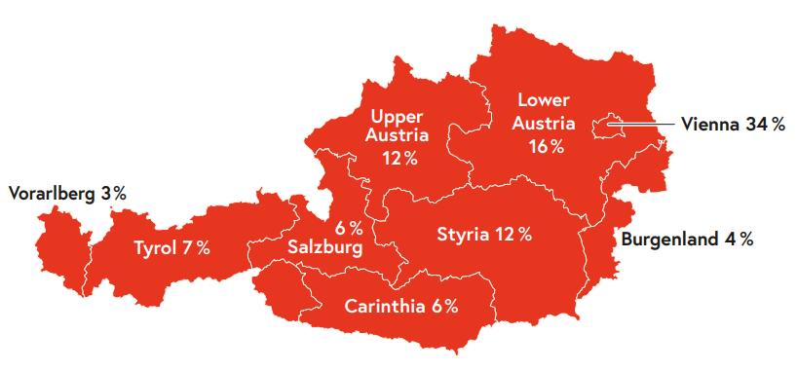
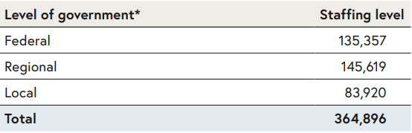
Levels of Public Administration
Public Administration in Austria is carried out at three levels:
Federal
9 Regions (Länder)
2,093 Municipalities

Slide 88
Organisational Structure of the Federal Civil Service
The tasks of the federal level of government are carried out by the 12 federal ministries and the Federal Chancellery.
Powers and tasks are allocated to the individual ministries primarily along the lines of policy areas
Laid down in the Federal Ministries Act (Bundesministeriengesetz)
Types of Employment
Public-law employment (i.e. “classic” civil servants - Beamte)
Private-law employment (i.e. contract staff - Vertragsbedienstete)
Notes:
The tasks of the federal level of government are carried out by the federal ministries and their subordinate institutions.
Powers and tasks of the individual ministries are allocated primarily along the lines of policy areas and they are laid out in the Federal Ministries Act (Bundesministeriengesetz)
The so-called supreme institutions, such as the Constitutional Court or the Court of Audit, enjoy a special level of autonomy and independence as they monitor other government institutions.

Slide 89
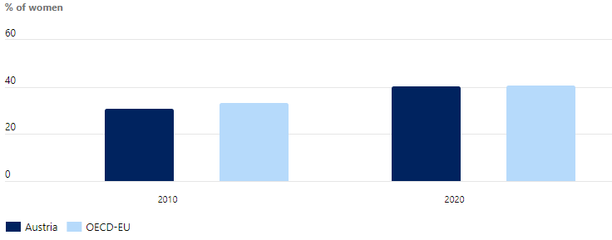
Gender equality in senior management positions in national administration, 2021
40,5%
31,2%
Notes:
Equal representation of women and men in the public sector is a key indicator of progress towards gender equality, diversity and better representation. In 2020, a majority of employees in the public sector in OECD countries were women (58.9%), with large differences among countries. However, women are often under-represented in managerial positions.
Austria aligns with the OECD-EU average on the representation of women in senior management positions in the national administration (40.5% against 40.8%). In turn, women’s representation in ministerial position (40%) is above the OECD average (36%), yet still below gender parity.

Slide 90
Set of values for good leadership
Since 1st January 2025 Art 32 of the Civil Servants Employment Act (Beamten-Dienstrechtsgesetz 1979 – BDG)
Defines key competencies for Federal public employees with managerial tasks (in general starting with middle management up to DG-level)
The article also foresees a mandatory training for all relevant managers
The managers have five years to complete the trainings. This also applies to managers who have been appointed since 1 January 2022, with the five-year period starting on 1 January 2025.
Notes:
Development of the leadership values: The amendment of Art 32 BDG was adopted according to the defined legislative process.

Slide 91
Key Leadership Values 1/2 (as stated by law)
Design, management and quality development of the organisational unit in terms of overall administration, organisational goals and productivity.
Context-appropriate, socially communicative and role-flexible behaviour with the aim of promoting teamwork and the potential of employees and achieving organisational goals,
Ability to analyse the organisational framework (e.g. political, economic, social) of the organisation and its further development, particularly taking into account the conditions in the European Union,
Knowledge of budgetary regulations (in particular budget, impact orientation, procurement, contracts, subsidies) and ability to apply and implement them,

Slide 92
Key Leadership Values 2/2 (as stated by law)
Development and use of networking and cooperation opportunities and support for the associated processes,
Knowledge of compliance and corresponding personal conduct and actions,
Knowledge and practical skills relating to diversity management, human resources management and human resources development.
Recognition of digital requirements and further developments for the relevant work processes, implementation capabilities and impact assessment.
Please note that the ministries have additional leadership values.
Notes:
Challenges: huge turnover of managers and need for new workforce because of demographical change, recruitment challenges because of war for talents, further a highly complex environment and the need of digitalization of the public administration.

Slide 93
Set of values implemented in practice
Relevant trainings, seminars and course of lectures are offered by the Austrian Federal Academy of Administration (Verwaltungsakademie des Bundes - VAB) as the central training institute for the Austrian Federal Administration.
Ministries offer inhouse training:
Federal Ministry of Finance Bundesfinanzakademie,
Federal Ministry of Interior Die Sicherheitsakademie,
Federal Ministry of Defence Bundesministerium für Landesverteidigung - Landesverteidigungsakademie.

Slide 94
Executive Management Training (EMP)
The EMP ( Campus – Öffentlicher Dienst ) provided by the Austrian School of Government ( Austrian School of Government - Federal Chancellery ) is reserved for top managers (like DGs) with adequate leadership and practical experience.
Learning Components per Module Core Components Lectures: In-depth exploration of module topics through current knowledge, discussions, and ethical reflection for innovative implementation Learning Journeys: Collaborative visits exploring module themes in new contexts and perspectives Think Tank: Strategic platform for analyzing administrative potential, challenges, and developing solution approaches Administration in Discourse (additional): Open discussion events on current relevant topics - accessible to all target group members regardless of program participation
Notes:
Learning Journeys: Gemeinsame Besuche und Auseinandersetzungen mit dem Modulthema in neuen Kontexten und aus ungewohnten Perspektiven • Micro-Learnings: Elektronisch bereitgestellte Inhalte zur Schaffung eines gemeinsamen Verständnisses des Themenfeldes, der Begriffswelt und der theoretischen Grundlagen. • Modul-Lehrveranstaltungen / Lectures: Vertiefte Auseinandersetzung mit den Modulthemen durch Sichtung aktueller Wissensbestände, Diskussionen und Reflexion von Werthaltungen und ethischen Aspekten zur Implementierung innovativer Ideen. • Coaching Basket: Hochgradig individualisierte 1:1-Gespräche mit Spezialist:innen und Expert:innen aus Wissenschaft, Wirtschaft und Praxis • Begleitende Diskurs-Veranstaltungen: Diskussion aktueller und relevanter Themen

Slide 95
Modules Executive Management Training (EMP)
Global Leadership and Strategic Action
Digital Transformation
Economic Policy and Budget Law
Ministry Leadership and Organizational Management
Strategic Human Resource Management and Development
Leadership and Team Development
Governance and Anti-Corruption
Partnerships and Stakeholders
Customized attendance possible with continuous reflection and evaluation processes Minimum requirement: Completion of Lectures (Art. 32 of the Civil Servants Employment Act )

Slide 96
Evaluation & Challenges
Evaluation of the values
Since the relevant amendment only came into force on 1st January 2025 it has not been evaluated yet.
The programs of the different academies are continuously evaluated and if necessary modified.
Challenges of implementing
Several challenges, especially due to tense budget situation.
Challenging to implement retroactively, particularly because there is no general implementation guideline.

Slide 97
Thank you for your attention!
Sabine Piska-Schmidt
Head of Department III/4 – Personnel Development, Personnel Selection and Mobility
sabine.piska-schmidt@bka.gv.at

Slide 98





IMPLEMENTATION OF A COMPETENCY FRAMEWORK
Radka Fišerová, CZECH REPUBLIC
29.9. 2025

Slide 99
Competency framework is part of a bigger project
Part of a „National recovery plan – Creating an action plan for human resources development“
Competency framework:
The competency framework is the basic for human resource management.
It is like a map of the abilities, skills, and knowledge that a person needs to succeed in a particular position or role.
Defines what is expected from a person to know and be able to do. It helps people understand what skills they need to develop and helps organizations select and evaluate employees.
It is a tool that supports development and growth, whether for an individual or an entire team.
Notes:
Aneta

Slide 100


Why we need a competency framework?
We need to adapt to change.
Civil servants must be able to handle digital challenges and provide efficient, transparent services that not only meet citizens´ needs but also strengthen trust in a functioning state.
By 2030, 59 % of employees will require upskilling or reskilling.*
We need to improve employee motivation and satisfaction.
Only one-third of civil servants rated their professional development as sufficient in the CIVIL SERVANT PERSPECTIVE survey, and less than half receive constructive feedback.
When people can learn and grow, they see more meaning in their work, which increases satisfaction and loyalty.
*The World Economic Forum
Notes:
Aneta

Slide 101


.. and also
Hiring the right people for the right positions.
Competency-based recruitment ensures that new employees not only have the necessary knowledge, but also the key skills and abilities to succeed in their role.
People whose skills match the requirements are more satisfied and less likely to leave.
Prepare future leaders.
Many civil servants are approaching retirement age, creating a need to prepare new managers.
Thanks to development programs and effective recruitment, the service authority has qualified leaders who can naturally take on key roles.
Notes:
Aneta

Slide 102



Employee development based on the competency framework…
.. is targeted, effective, and beneficial not only for employees but also for service authority, citizens and society.
The employee knows what abilities, skills, and knowledge are key to success in the role.
The service authority has a clear overview of how to invest in development.
Citizens can be confident that the institution has qualified experts at its disposal who will provide them with an appropriate level of service.
Notes:
Aneta

Slide 103

COMPETENCY FRAMEWORK AND ITS RELEVANCE TO OTHER HR PROCESSES
Notes:
Radka

Slide 104

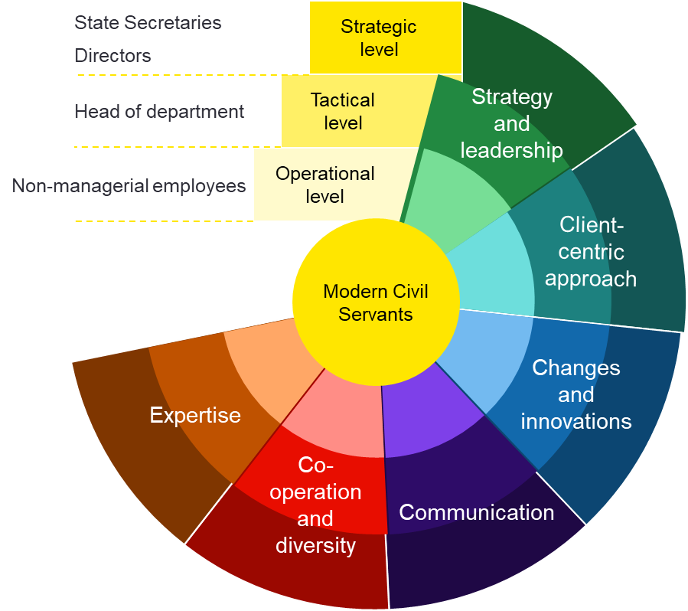



The competency framework is an imput for HR management
Hiring
Training and development
Onboarding
Performance management
Notes:
Radka

Slide 105
OUR COMPETENCY FRAMEWORK
Notes:
RF

Slide 106
Competency framework – basic parameters
One competency framework for all
Defines what is expected of civil servants
Reflects the different needs of individual levels of service authority
Only priority competencies are listed, but each has multiple areas
Individual competencies describe the expected behavior according to management level (management, specialists).
The highest level of expertise is expected at the operational level
The competency Expertise is not part of Development and Training in the Pilot Phase - it must first be correctly described for individual systematized positions.
Notes:
RF

Slide 107
Očekávaný projev chování úředníka na Strategické úrovni
 | Aktivně přispívá k tvorbě vize a mise úřadu či gesčně svěřené oblasti. Vizi a misi státní správy formuluje a prezentuje natolik jasně a konkrétně, aby byla srozumitelná pro všechny zaměstnance. Pro všechny své (i svěřené) útvary stanovuje cíle a indikátory , včetně nástrojů k jejich dosažení. Vytváří a prezentuje strategický plán s konkrétními kroky a časovým harmonogramem pro jeho realizaci. Pracuje na vytváření a udržování strategických partnerství a spolupráce s dalšími institucemi nebo mezinárodními organizacemi. Rozvíjí tým v souladu s individuálními schopnostmi a dovednostmi členů tak, aby mohl adekvátně delegovat úkoly a odpovědnosti; řídí priority a zdroje tak, aby byly splněny stanovené cíle odboru/sekce. Dokáže se přizpůsobit a efektivně reaguje na odklon od stanovených cílů, včetně nečekaných událostí a změn v legislativě, politickém prostředí či prioritách úřadu. Efektivně řídí a plánuje i v době nejistoty a stresu, přičemž zachovává klid a jasno v myšlení. Nevytváří a nepřenáší stres a nejistotu na ostatní zaměstnance či další osoby. Při řízení a plánování má na paměti a zajišťuje rovnováhu mezi soukromým a pracovním životem, zohledňuje individuální potřeby své i svých podřízených. Vede zaměstnance ve svém útvaru k jednání podle pravidel etiky a pravidel chování. Osobně je v tomto příkladem.
 | Formuluje strategie a iniciativy, které zlepšují poskytované služby a zvyšují transparentnost a dostupnost informací pro interní i externí klienty. Nastavuje pro sebe i svůj úřad cíle a ukazatele výkonnosti týkající se fungování úřadu (zejm. zlepšení služeb občanům poskytovaných státní správou), aktivně sleduje a zajišťuje jejich dosahování. Podporuje a propaguje orientaci na klienta a respekt vůči občanům ve všech úrovních státní správy. Jedná s ohledem na potřeby interních i externích klientů a stejný přístup požaduje i od všech zaměstnanců. Aktivně se účastní akcí, kde získává informace a přehled o dění ve své oblasti, pravidelně získává zpětnou vazbu a aktivně s ní pracuje na zlepšování služeb. Zajišťuje, že potřeby a očekávání občanů jsou brány v úvahu při tvorbě politik a rozhodování.
 | Aktivně vytváří mechanismy a prostředí pro podporu inovací a motivuje zaměstnance k tomu, aby přicházeli s novými nápady a přístupy. Řídí změny v organizaci a aktivně se věnuje identifikaci a řízení rizik spojených s implementací změn. Sleduje celkové trendy ve společnosti a úřadu a přizpůsobuje strategii a činnosti novému vývoji a potřebám. Rozvíjí své digitální dovednosti, zapojuje se do nových digitálních projektů a úkolů jako způsobu učení se praxí a podporuje zaměstnance k využívání nových technologií a postupů v rámci jejich každodenní práce.
 | Prezentuje strategické směry a úspěchy sekce/odboru navenek s jasností a přesvědčivostí za účelem posílení důvěry a pověsti organizace. Aktivně a pravidelně komunikuje s členy svého útvaru, sděluje jim srozumitelně a jasně klíčové informace a cíle sekce/odboru. Komunikuje s různými zúčastněnými stranami včetně veřejnosti, samosprávy, jiných orgánů státní správy, partnerů, nadřízených a podřízených. Komunikuje s respektem, transparentností a empatií a přizpůsobuje svůj jazyk a styl komunikace cílovému publiku. Zajišťuje, aby klíčové informace a zprávy byly sdělovány transparentně a včas.
 | Motivuje svůj útvar k dosažení strategických plánů a cílů odboru/sekce. Utváří podpůrné prostředí pro růst a rozvoj (osobní i profesní) podřízených, včetně poskytování relevantní zpětné vazby podřízeným a příjímání zpětné vazby od podřízených a sebereflexe. Podporuje spolupráci mezi resorty v situacích, kde je tato spolupráce vhodná nebo klíčová. Ve svém útvaru podporuje diverzitu (genderovou, věkovou, vzdělanostní, zkušenostní, diverzitu pracovního prostředí a délky úvazku) a vytváří tak efektivní prostředí s různými pohledy na řešení problémů. Vytváří prostředí důvěry a spolupráce mezi různými skupinami zaměstnanců, podporuje tak harmonické pracovní prostředí a dobré mezilidské vztahy v týmu.
Státní tajemníci
Vrchní ředitelé
Ředitelé sekcí a odborů
Strategická úroveň
Vedoucí oddělení
Taktická úroveň
Strategie a leadership
Řadoví zaměstnanci
Operativní úroveň
Moderní úřednictvo
Proklientský přístup
Změny a inovace
Odbornost
Spolupráce a diverzita
Komunikace
Notes:
RF

Slide 108
PILOT - LESSONS LEARNED
Notes:
Aneta

Slide 109
Pilot – lessons learned
Most managers:
are unable to give realistic and constructive feedback;
are afraid to give negative feedback;
tend to over-evaluate their employees during feedback session.
Some managers lack sufficient knowledge of their staff, which prevented them from providing a proper evaluation.
Targeted development of managerial competencies is missing. Some managers do not want to let their employees attend these development activities, only professional training.
Significant delays were a major obstacle, caused by the late submission of required materials by participants. A significant difference was visible in well-managed institution, where delays were almost non-existent.
The pilot was based on a voluntary principle, resulting in a lack of participation from those who need it most.
We must simplify the development matrix, as it is too complex.
Notes:
RF

Slide 110
PILOT – NEXT STEPS
Notes:
Aneta

Slide 111
Pilot – next steps
Other institutions are requesting to join the activity on their own – we need to give them the relevant support.
We still need to ensure:
The completion of ongoing development and training.
The preparation and delivery of an action plan to the government.
The preparation of a unified training program (managerial academy) for institutions´ top management.
Notes:
RF

Slide 112
Thank you for your attention

Slide 113

Five expectations for good leadership in the Norwegian state sector
Tone K. Kastnes
Head of Section
Notes:
"Good afternoon, my name is Tone Kastnes, I am Head of Section at the Norwegian Agency for Public and Financial Management (DFØ).
First, let me thank my Austrian and Czech colleagues for their very interesting presentations, and thank you for the opportunity to present the Norwegian perspective.
Today, I will briefly present how we in Norway have developed and implemented five overarching expectations for good leadership in the state sector."

Slide 114

The Framework
Developed by the Ministry of Digitalisation and Public Governance and DFØ
Alligned with the State Employer Strategy launched in 2024
Applies to all leaders in the state sector
Notes:
The Foundations for Good Leadership were launched in 2024, developed by the Ministry of Digitalization and Public Gorvnance (DFD) and DFØ, and are linked to the State Employer Strategy. It applies to all state leaders and is meant as a basis for reflection, not a checklist.
The Ministry holds overall policy responsibility, while DFØ leads development and provides practical guidance.
(The State Employer Strategy aims to help the public sector retain, develop, and recruit competent employees in the future.)

Slide 115
Why shared expectations for good leadership in the Norwegian state sector?
Shared direction across the state sector
Respond to challenges: ageing population, AI, climate, security
Notes:
The Forundation give a common direction: and provide a shared language for leadership across ministries and agencies
The expectations themselves were developed to respond to long-term challenges like an ageing population, resource scarcity, technological change, climate change and a changed security situation.
Let me briefly explain the process of developing the expectations

Slide 116
How we developed the expectations?
Broad involvement: leaders, HR, unions, researchers, consultants
Anchored in state sector values
Replaced earlier frameworks (2008, 2014)
Designed for reflection – not a checklist
Notes:
True to Norwegian form. The process was just as important as the result.
The Ministry and DFØ led the development, but we made sure it was a co-creation effort.
We involved leaders and HR professionals from ministries and agencies, the main trade unions, researchers, and consultants. This broad involvement was crucial for legitimacy.
The expectations are firmly anchored in core state sector values, and they build on – but also replace – earlier frameworks, such as the Platform for Leadership from 2008 and the Leadership Poster from 2014.
And importantly: they are not meant as a checklist, but as a basis for reflection and dialogue
So now it’s probably about time I reveal what the expectations are.

Slide 117
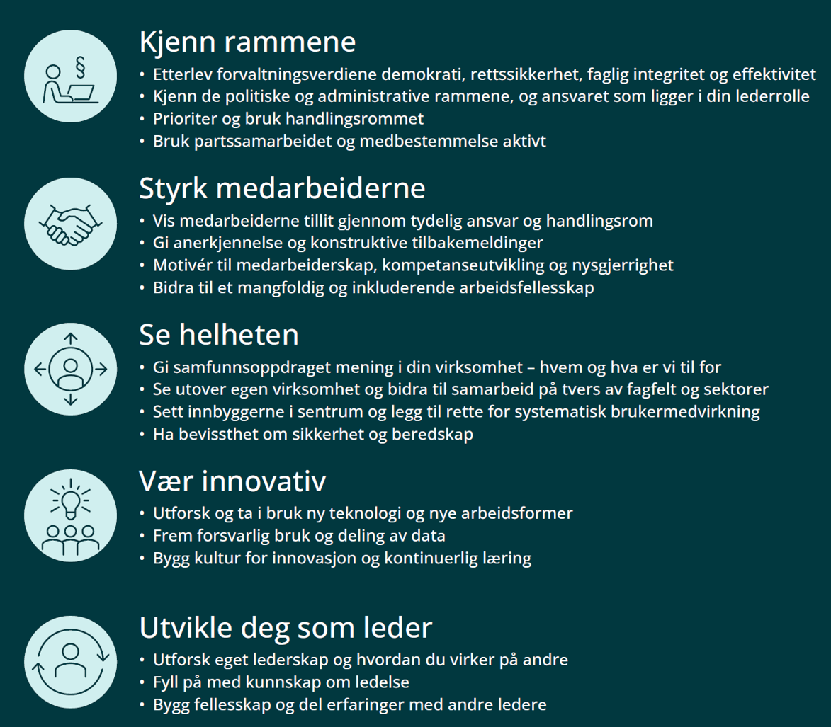
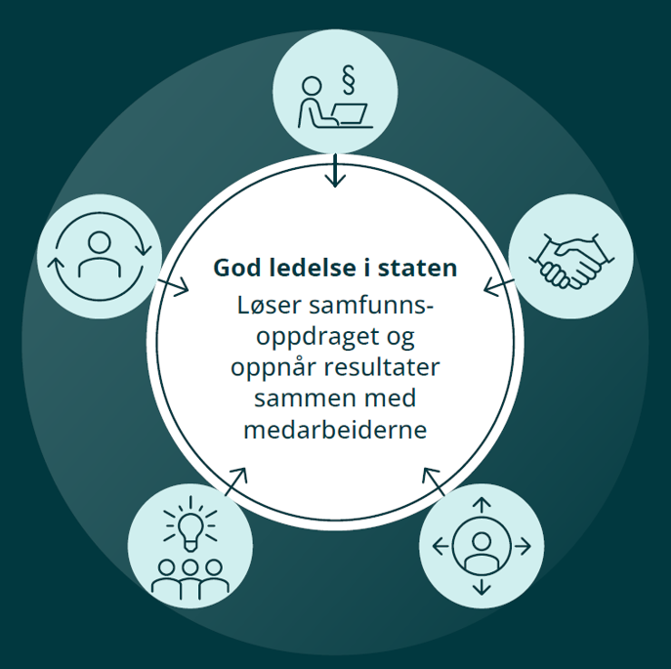
Know the framework
Empower employees
See the bigger picture
Be innovative
Develop yourself as a leader
Five expectations for good leadership
Leaders and employees work together to achieve the mission
Ministry of Digitalisation and Public Governance
Ministry of Digitalisation and Public Governance
Notes:
At the center of the illustration, we ca read: Leaders and employees work together to achieve the mission"
This central statement highlights that effective leadership in the Norwegian public sector is built on collaboration.
It shows that all five expectations—knowing the framework, empowering employees, seeing the whole picture, being innovative, and developing as a leader—are interconnected, and that achieving the organization’s mission requires shared responsibility and teamwork.
Let me walk you through the five expectations

Slide 118
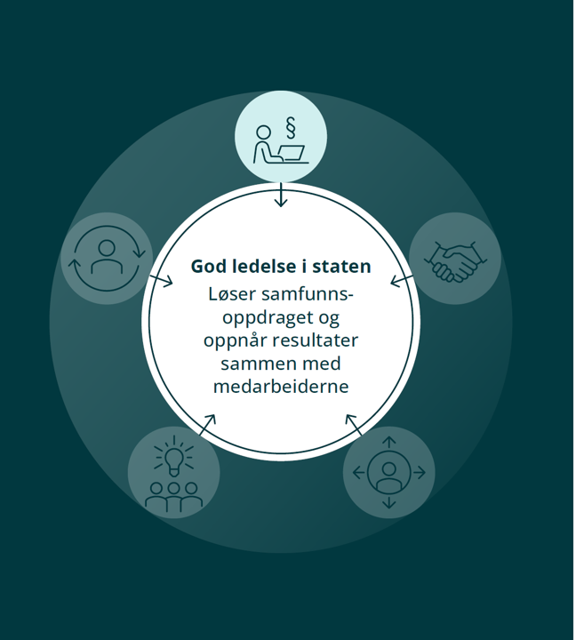
Know the framework
Respect democratic values, laws, rules
Understand political/administrative context
Cooperate with unions and use room for action
Leaders and employees work together to achieve the mission
Notes:
Expectation number 1: Know the framework
Leaders must understand the political and administrative framework in which they operate.
This includes respecting democracy, the rule of law, and integrity as well as engaging in dialogue with employee representatives.
A deep understanding of the framework builds trust and legitimacy in leadership decisions.

Slide 119
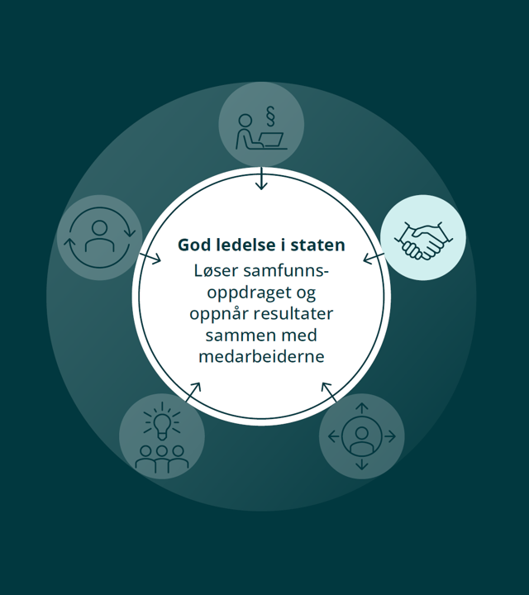
Empower employees
Build trust and recognition
Strengthen competence and inclusion
Support professional development
Leaders and employees work together to achieve the mission
Notes:
Expectation 2: Empower your employees
Leaders should create an environment where employees feel empowered to take action, trust is built, and recognition is given.
Empowerment also involves promoting continuous learning and fostering inclusion.
This approach reflects our Nordic tradition of actively involving employees in decision-making.

Slide 120
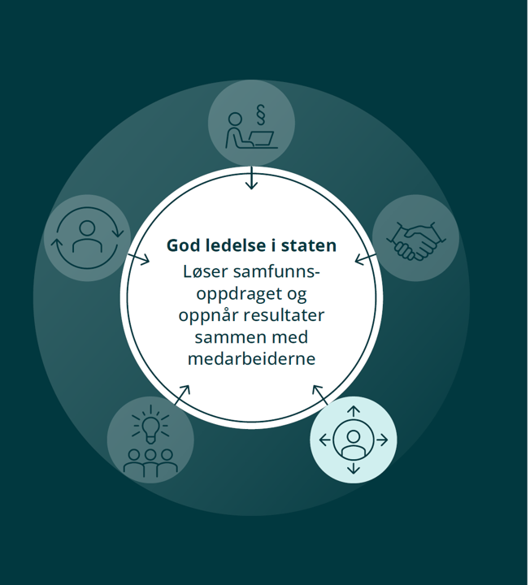
See the bigger picture
Keep the societal mission in focus
Work across sectors and boundaries
User orientation and preparedness
Leaders and employees work together to achieve the mission
Notes:
Expectation 3: See the bigger picture
Leaders should connect their organisation’s work to broader societal goals.
They must collaborate across sectors and agencies, keep citizens at the centre, and ensure readiness for security and crisis situations.
Seeing the bigger picture strengthens coordination and resilience in the civil service.

Slide 121
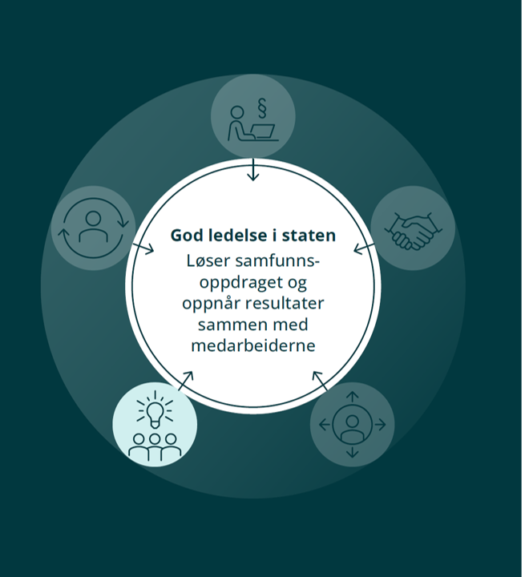
Be innovative
Use technology and new work methods
Encourage experimentation and learning
Ensure responsible and ethical data use
Leaders and employees work together to achieve the mission
Notes:
Expectation 4: Be innovative
Leaders must adapt and find new ways of working, including making use of technology such as AI.
Innovation is not only about efficiency, but also about addressing complex challenges like climate change and the green transition.
Responsible innovation helps prepare the state sector for the future.

Slide 122
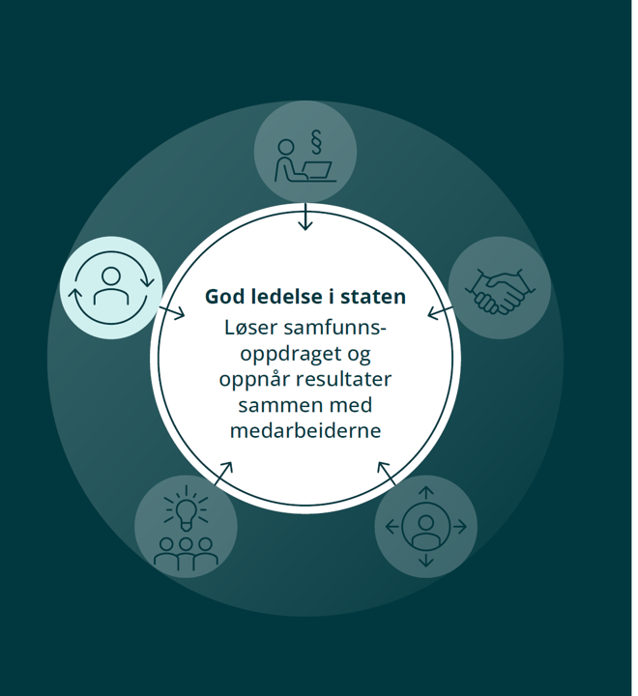
Develop yourself as a leader
Reflect on your leadership and impact
Seek feedback and continuous learning
Be part of a leadership community
Leaders and employees work together to achieve the mission
Notes:
Expectation 5: Develop yourself as a leader
Leadership requires continuous reflection and development.
Leaders are expected to consider how they affect others, strengthen their competence, and share experiences with peers.
This contributes to a culture of learning and improvement across the civil service

Slide 123
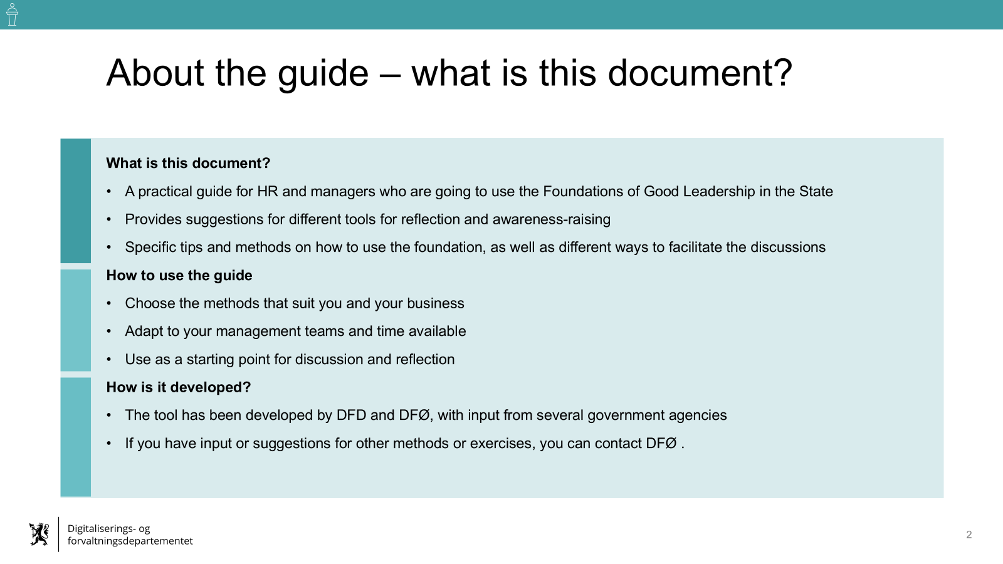
A dedicated guide and reflection material for HR and leaders
Designed to support leaders in discussing the five expectations with their teams and peers
Available as guides, questions and exercises – flexible for different contexts
Promotes dialogue, not compliance – it’s about shared understanding and learning
Encourages leaders to connect the framework to their own practice
Notes:
To support leaders and HR we developed a dedicated guide and reflection material for HR and leaders. ‘
It contains guiding questions and short exercises that leaders can use with their teams or peers.
This material is meant to spark dialogue and reflection.
The goal is to connect the expectations to everyday leadership practice and build a stronger learning culture.

Slide 124
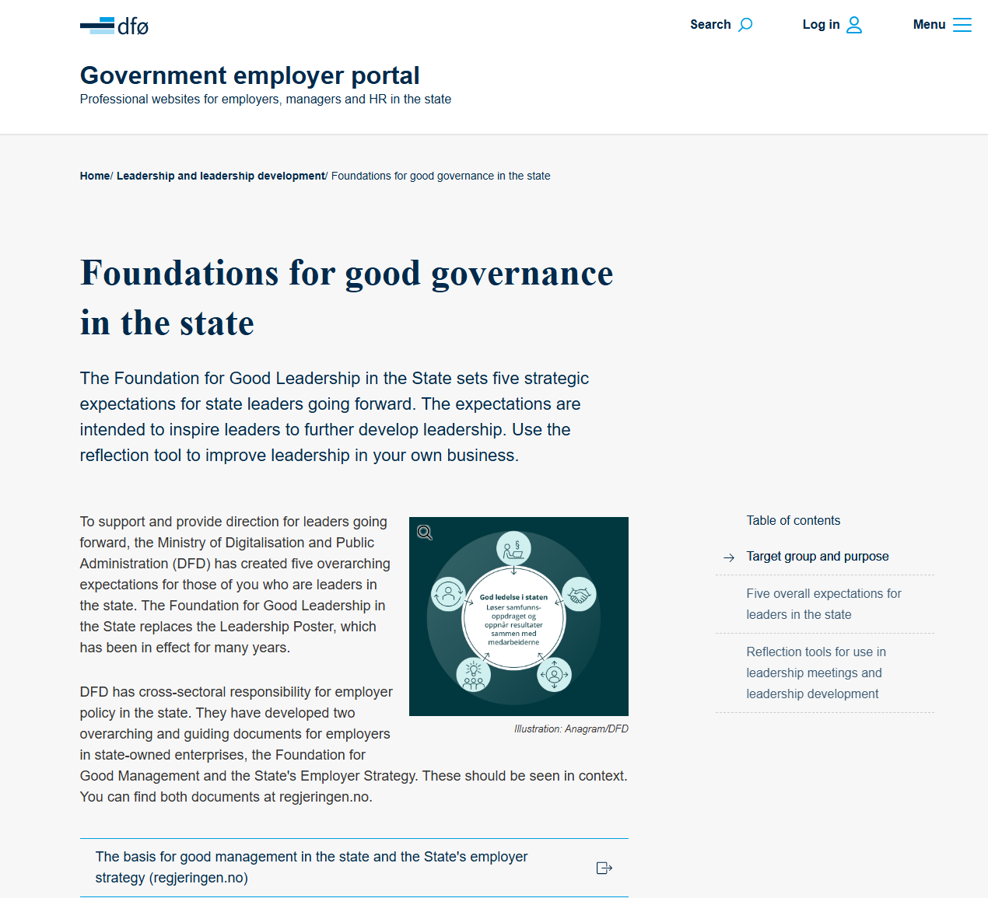
Additional implementation
Integrated into templates for performance reviews with leaders
A pilot for a leadership development program, based on the five expectations.
Survey 2024: 84 % of HR leaders have used framework
Notes:
In addition to the reflection guide
We have integrated the Framework into performance appraisal templates, ensuring that expectations become a natural part of managers' appraisals. We are also preparing a guide to use in recruitement situations and a reflection tool for the “lone”leader.
We have started developing a pilot project for a leadership development program based on the five expectations, which provides practical training and insights.
In our emplyer barometer for 2024, as many as 84% of HR managers have used the framework in meetings and more than half plan to integrate it into their programmes.
On the right-hand side, a screenshot from the Employer Portal is shown, which highlights the basis for good leadership in the state and provides access to relevant documents and tools. ______

Slide 125
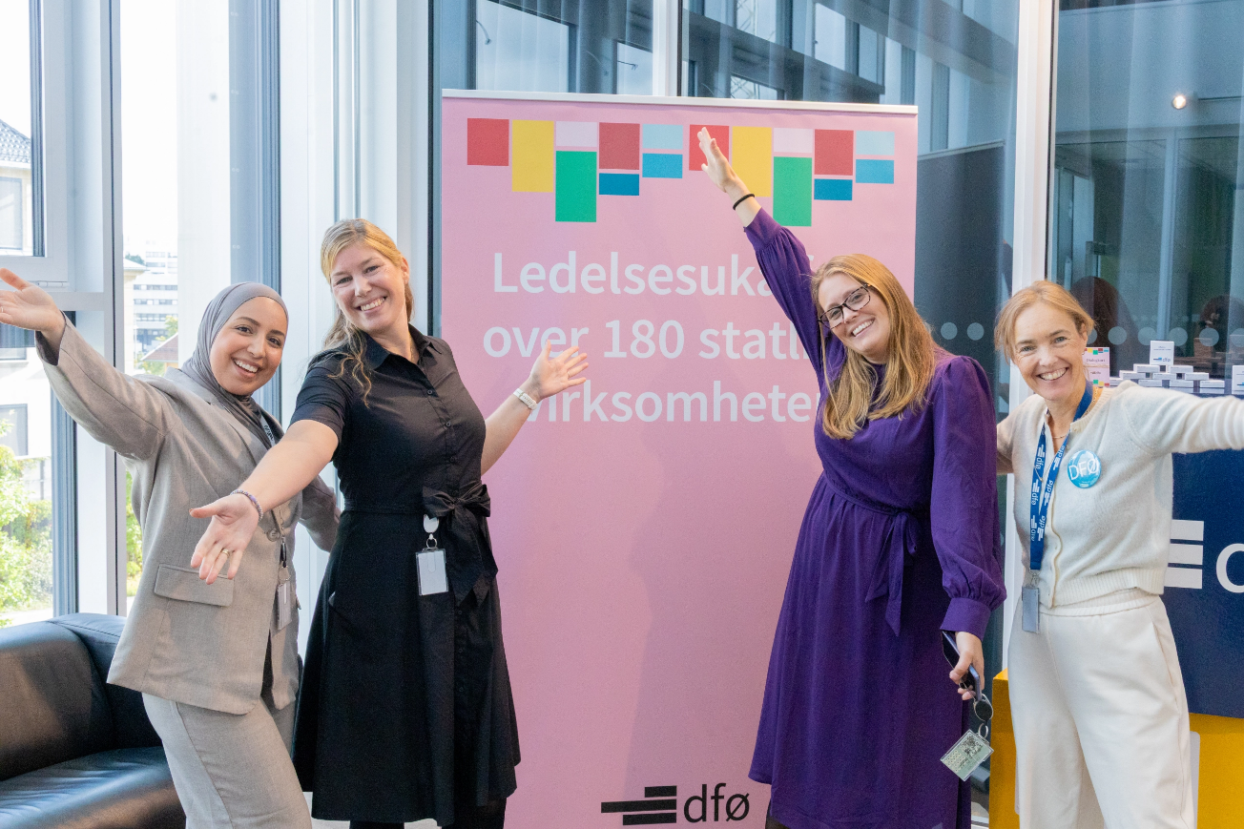


Leadership Week 2025
Nearly 4,000 participants
180+ state agencies
Physical, digital, and hybrid events
Portal for government employers
Photo: the DFØ team behind it
Notes:
This year, DFØ took a new step to strengthen the leadership community across the state sector. For the very first time, we organised Leadership Week in September.
We had close to 4,000 registered participants from more than 180 state agencies.
The programme combined physical, digital, and hybrid formats, which made it possible for leaders to join no matter where they are located.
The picture you see here is the happy DFØ team who made it all happen. They created a full week of seminars and workshops, on themes such as the future of leadership, AI, innovation, and digital transformation.
Leadership Week was designed as a new arena to share experiences, strengthen the leadership community, and reflect on the five expectations for good leadership.

Slide 126

Thank you!
Notes:
To sum up: the five expectations are not a checklist, but a shared language and direction for leadership in the Norwegian state sector.
They help leaders fulfil their mission, strengthen trust, and face future challenges.
We see this as a continuous journey – building leadership stone by stone, just like the Norwegians say, and learning from each other along the way.
I therefor look forward to your questions and reflections.
Thank you

Slide 127





Slide 128
Reflection in pairs/trios
What did you find most interesting?
What would you like the panel to elaborate on?
Just 5 minutes. Please write a few questions on the notes.

Slide 130
Thank you for participating in the Danish Presidency of EUPAN
September 2025

